Slide 1
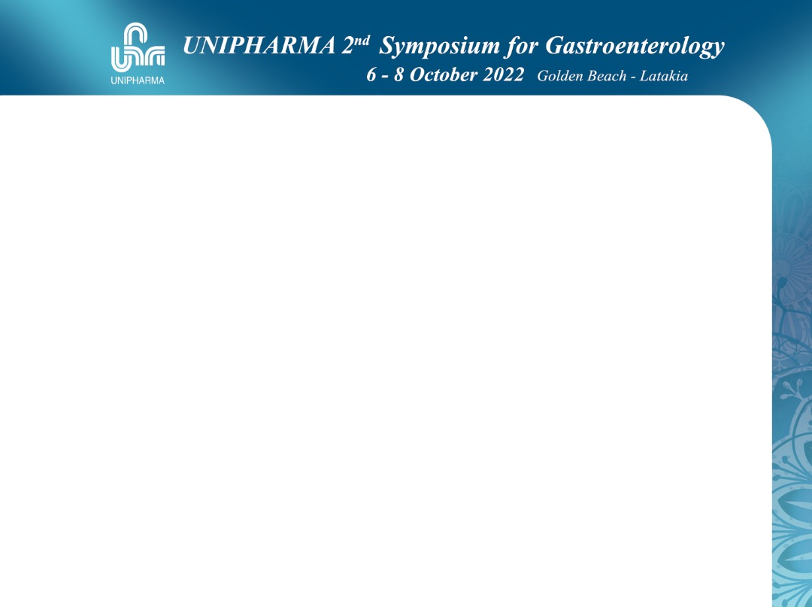


Slide 2
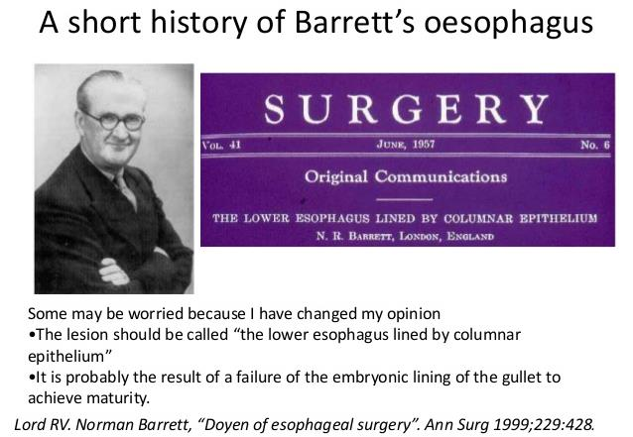

Slide 3
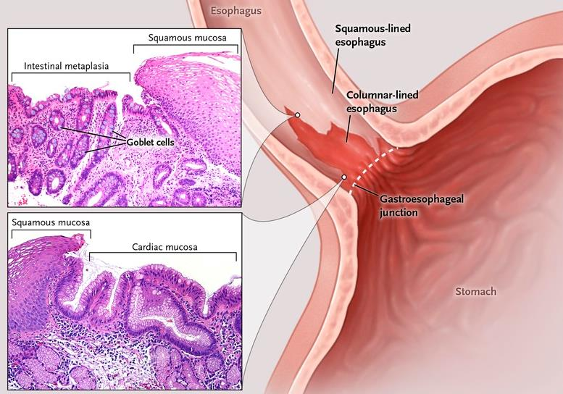
What Is Barret’s Esophagus ?

Slide 4
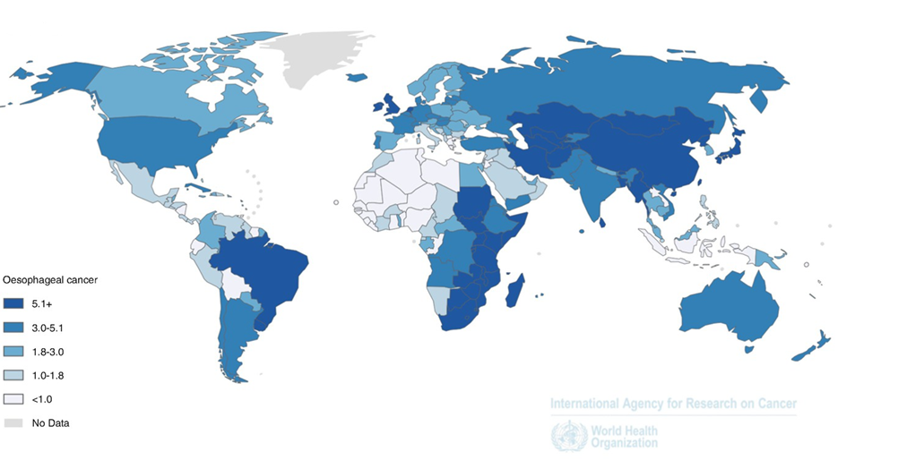
Previllance

Slide 5
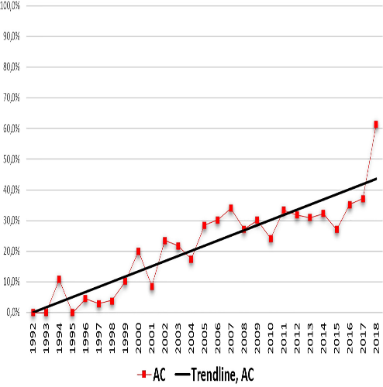
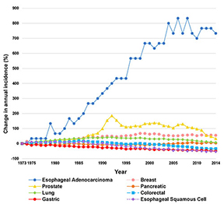
Dramatic Rise In EAC

Slide 6
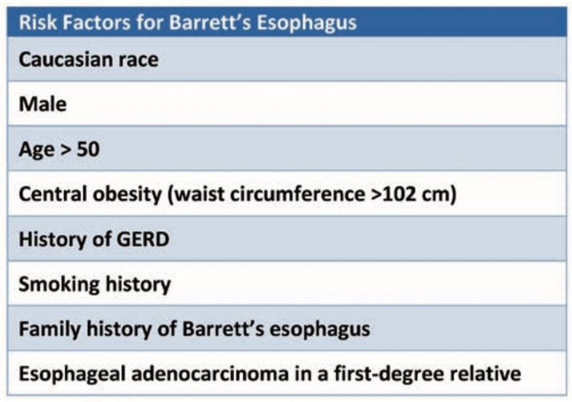
Risk Factors Progression To Barrett’s Esophagus

Slide 7
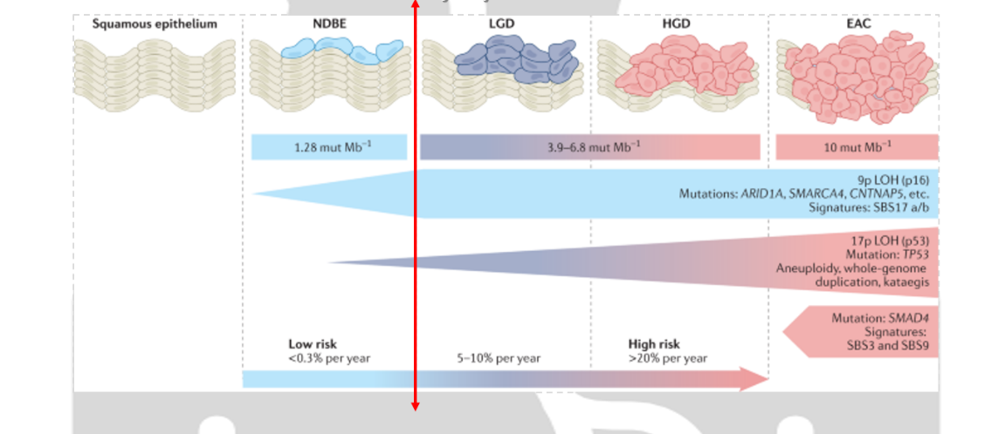
Cancer Risk In BE Based On Degree Of Dysplasia

Slide 8
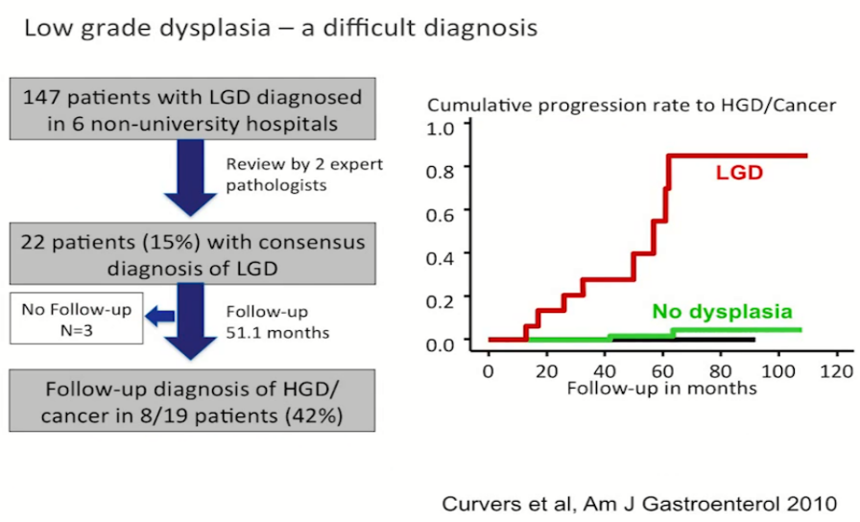
Progression In Barrett's Esophagus Point System Based On Risk Variables

Slide 9
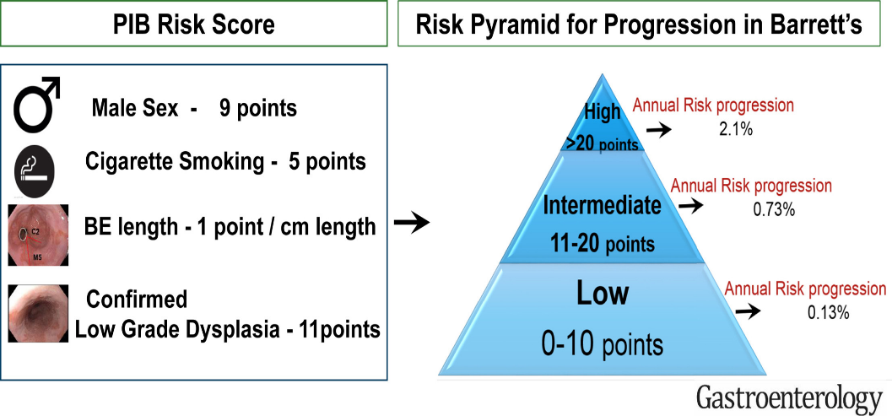
Progression In Barrett's Esophagus Point System Based On Risk Variables
Progression in Barrett’s Esophagus score(PIB)

Slide 10
Should We Screen For BE?
Pros
  early identification of patients who are at increased risk of EAC
  Timely decreasing mortality
  5-year survival rates increase from 17% to 74%
Cons
  90% of EAC do not have a prior diagnosis of BE
  ˃ 40% of patients with EAC do not have prior (GERD) symptoms
  sEGD cannot be used as screening tool
    expensive
    very low yield EAC in GERD patients
    some studies → no difference in survival

Slide 11
Should We Screen For BE?
Pros
  early identification of patients who are at increased risk of EAC
  Timely decreasing mortality.
  5-year survival rates increase from 17% to 74%
Cons
  90% of EAC do not have a prior diagnosis of BE
  ˃ 40% of patients with EAC do not have prior (GERD) symptoms
  sEGD cannot be used as screening tool
    expensive
    very low yield EAC in GERD patients
    some studies → no difference in survival
Single endoscopy for patients with chronic GERD symptoms and 3 or more additional risk factors :
1-males
2-age >50
3-White race
4-Smoking
5-Obesity
6-Family history of BE or EAC in a first-degree relative

Slide 12
Alternative Screening Technologies
swallowable, nonendoscopic devices with a biomarker…….
Cytosponge^{R}, EsophaCap^{R}, or Eso-Check^{R}

Slide 13
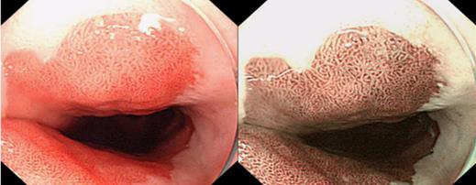
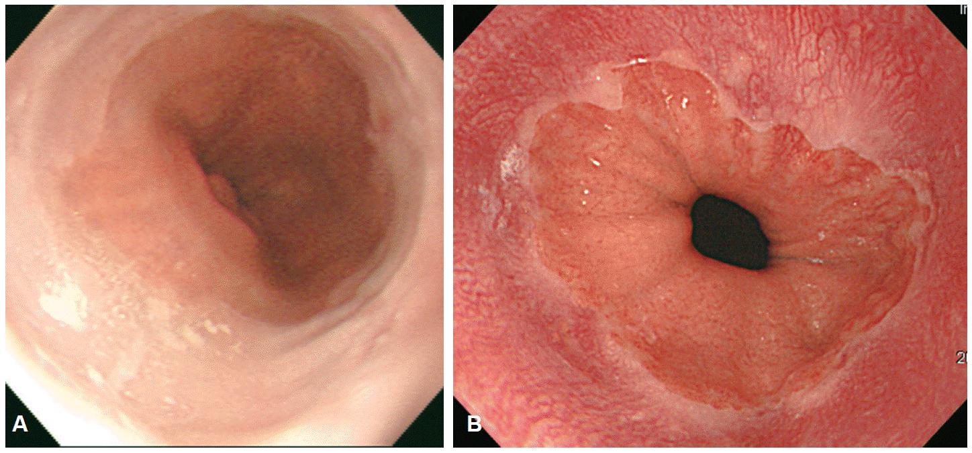
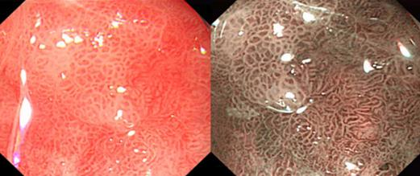
Surveillance Techniques: HD Vs SD Endosopy

Slide 14
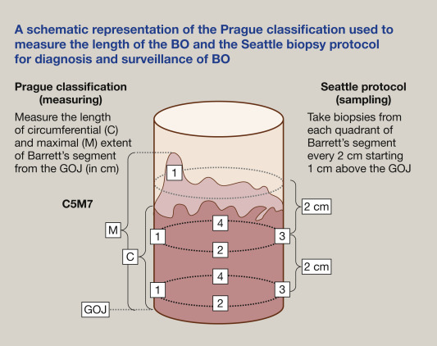
How To Screen?

Slide 15
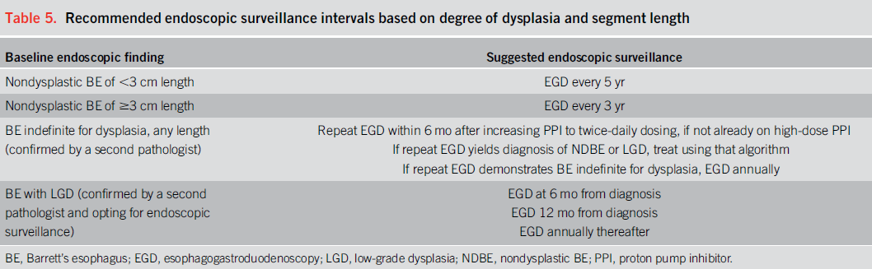
Indefinite BE

Slide 16
Updated Therapy → EET
(Eradication & Ablation)
EET has revolutionized the management of patients with Be-related neoplasia
an effective, minimally invasive treatment approach
Endoscopic resection (ER) of any visible lesion within the BE segment
Followed by ablative techniques such as RFA and cryotherapy to achieve complete eradication of dysplasia (CED)

Slide 17
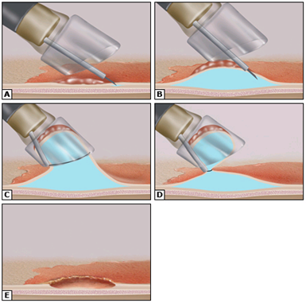
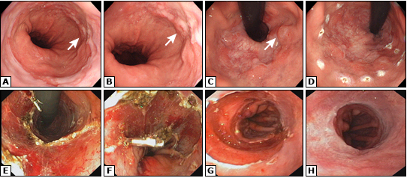
Steps Of Endoscopic Resection-cap Procedure

Slide 18
Multi-band Mucosectomy (MBM)

Slide 19
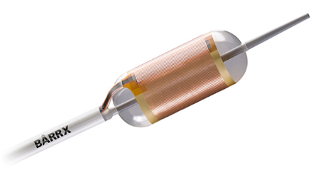
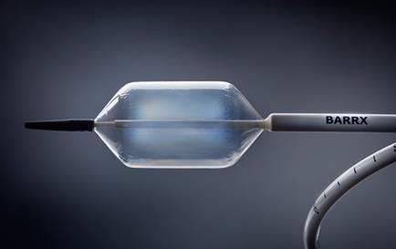
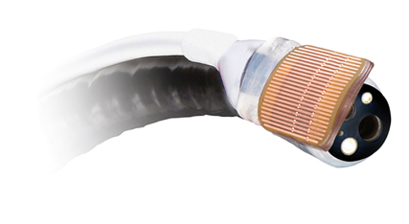
BARRX ablation system
BARRX360
BARRX90

Slide 20
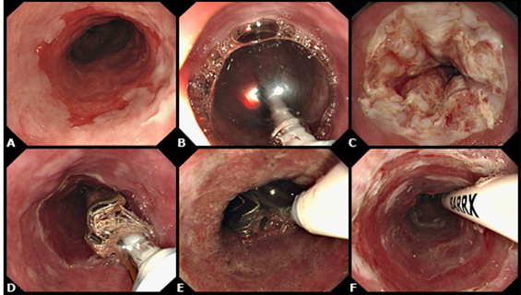
Primary Circumferential Ablation Of BE Using Barrx360 System

Slide 21
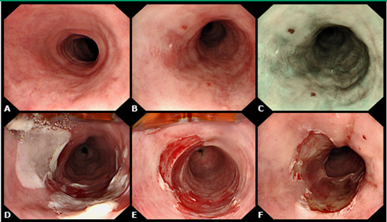
Focal Ablation Procedure For Residual BE Using Barrx90 System

Slide 22
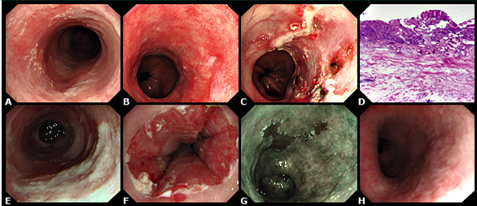
Early Cancer Treated With Combination ER & RFA Using Barrx System

Slide 23
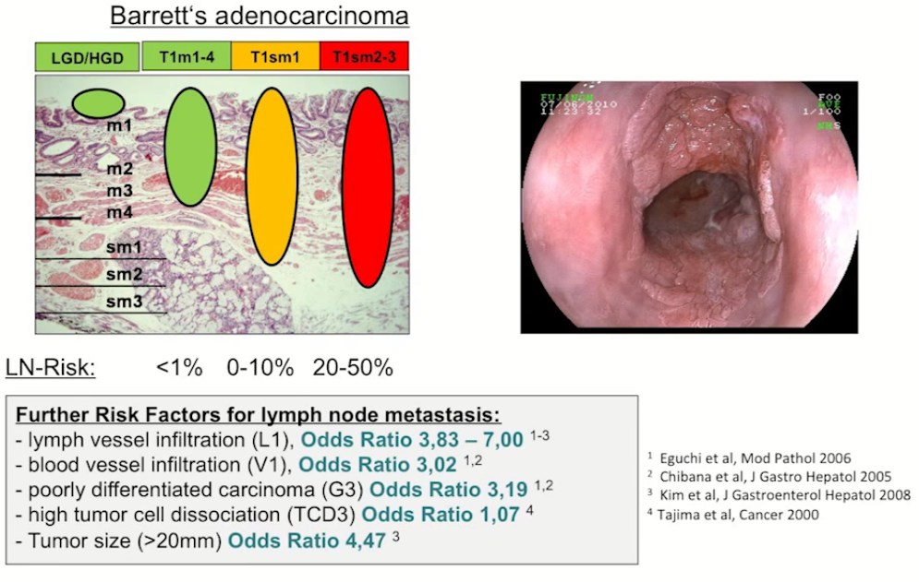
Contraindecations For ER

Slide 24
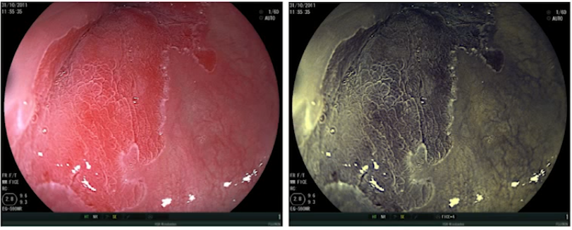
Low Grade Dysplasia

Slide 25
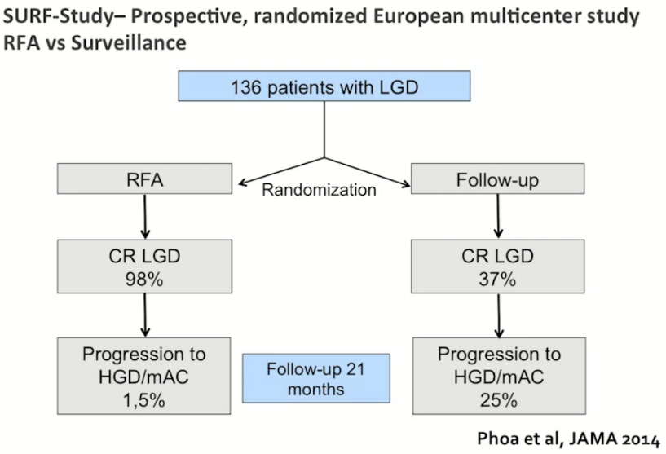

Slide 26
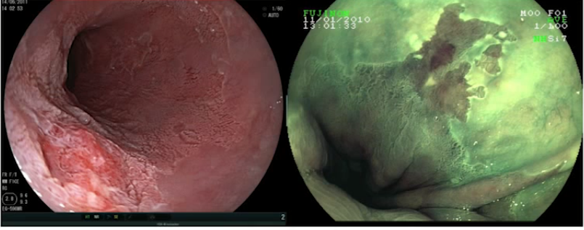
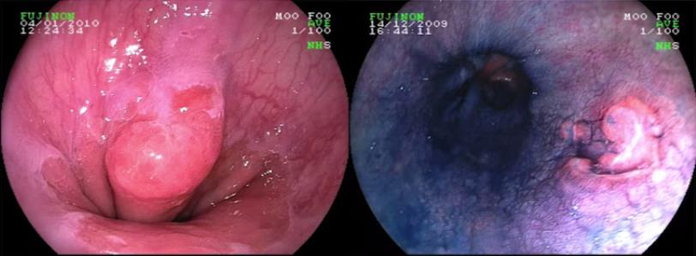
HGD/IMC

Slide 27
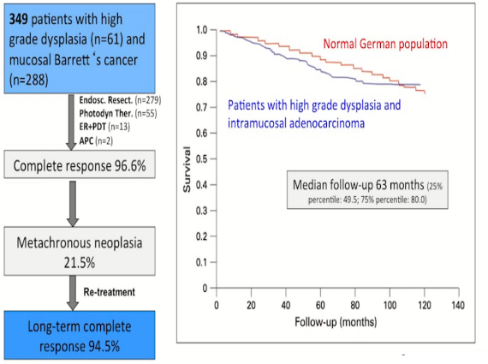
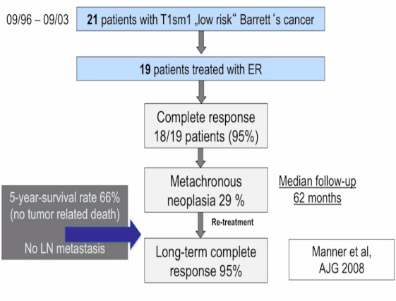
Endoscopic Treatment Of HGD And IMC

Slide 28
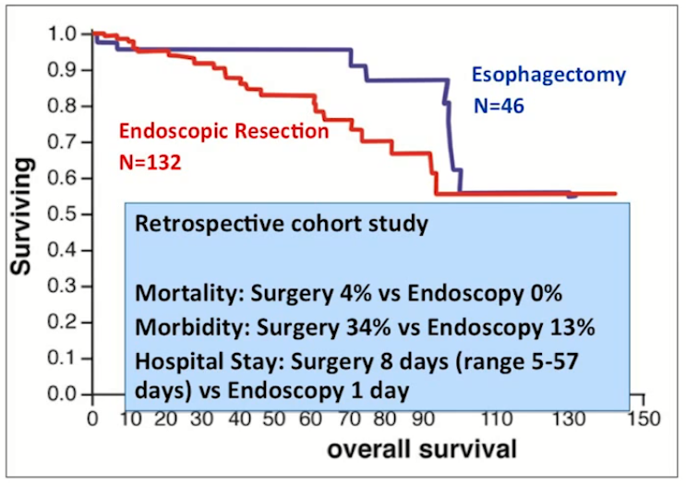
Endoscopic Resection Vs Esophagectomy In Intramucosal Adenocarcinoma

Slide 29
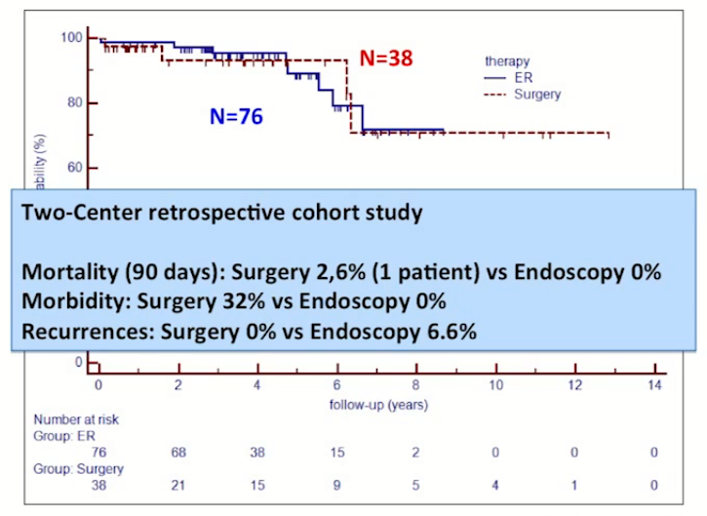
Endoscopic Resection Vs Esophagectomy In Intramucosal Adenocarcinoma

Slide 30
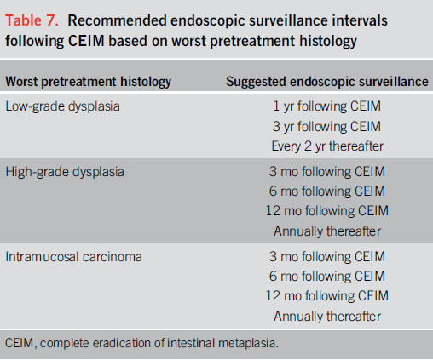
After Successful EET Surveillance Should Be

Slide 31


