Slide 1
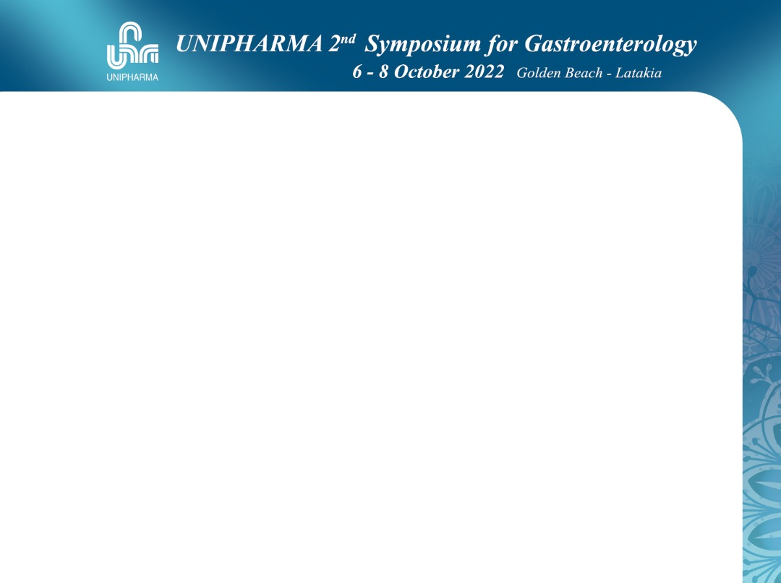
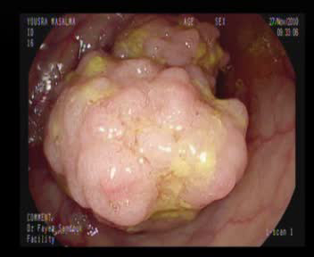
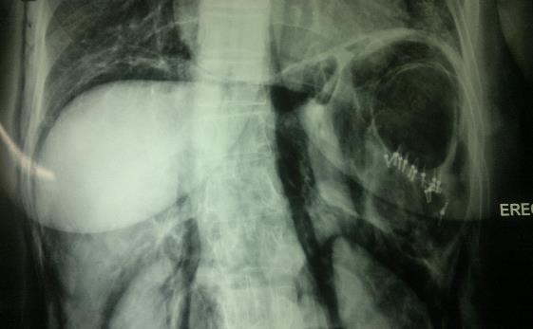
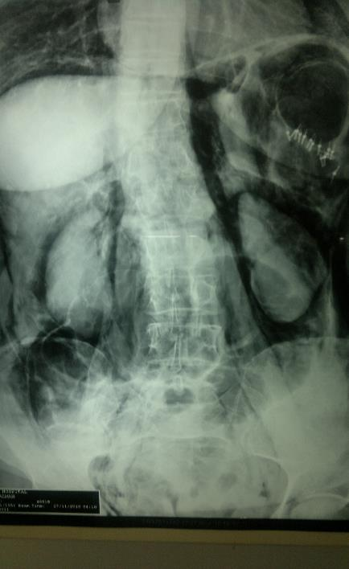
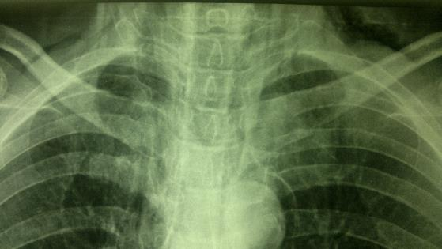
Case -1
32 yo F.
Huge Segmoid Polyp
Recurrent Rectal Bleeding
Polypectomy
Perforation , Clipping
Perforation case 15 clips

Slide 2
Case -1
32 yo F.
Polypectomy
Perforation , Clipping
SLide7

Slide 3
Case -2
82 yo M.
Huge Cecal Polyp
Recurrent Rectal Bleeding
Polypectomy
Perforation , Clipping
The Most Dangerous Area for Polypectomy
The Most Dangerous Area for Polypectomy
1
2
3
4
5

Slide 4
Case -3
5 yo M.
Big Fungating Mass
Anal Prolaps
Rectal Solitary Ulcer
Mycosectomy + Argon
دوكار 1 أمام
2 خلفي
3 حقن أمامي صعب
5 تقطيع مجزأ
7 مجموعة قطع
8 آرغون

Slide 5
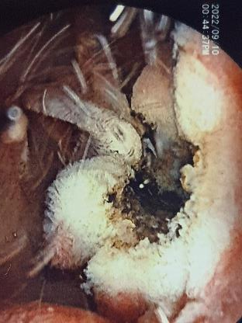
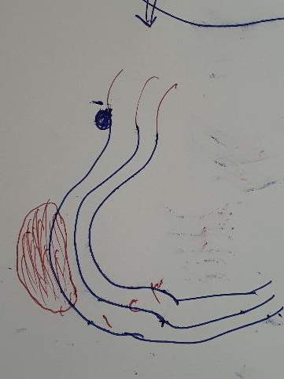
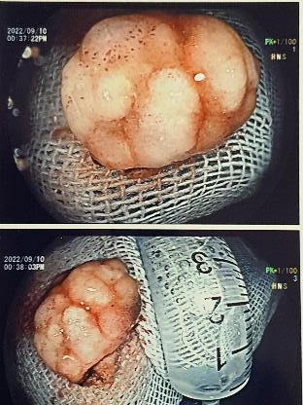
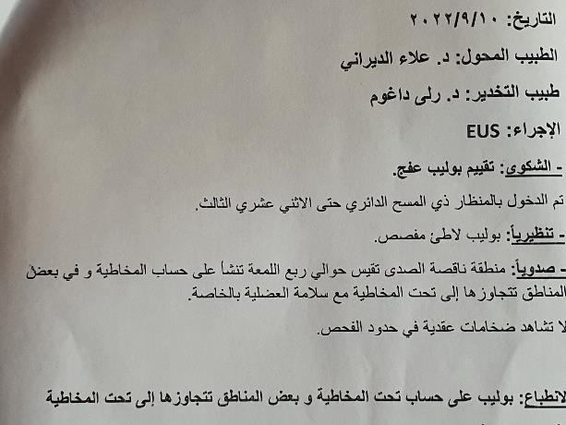
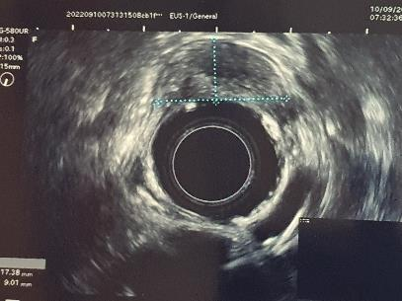
Case -4
52 yo M.
Huge Duodenal Polyp
1 cm below ampulla
Recurrent Anemia + OB
Mycosectomy + Argon
! Hyperplastic

Slide 6
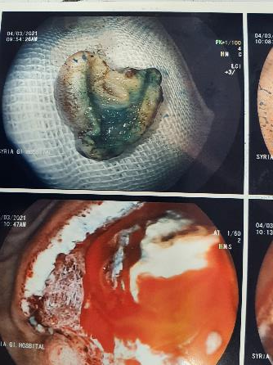
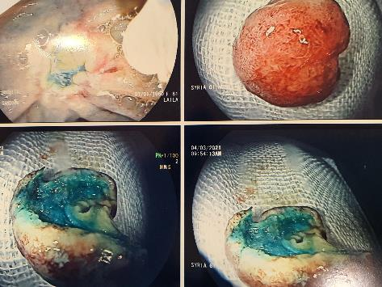
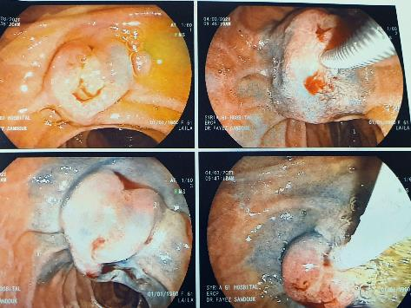
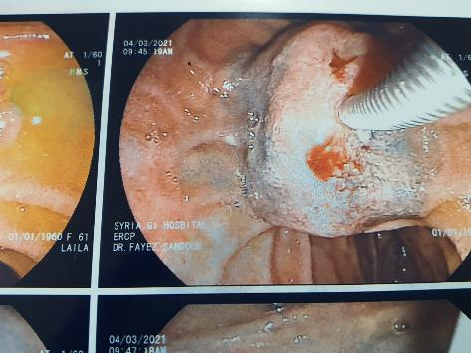
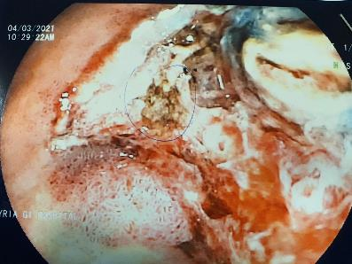
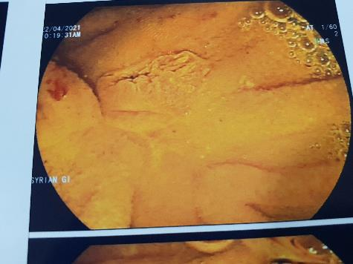
Case -5
45 yo M.
Ampullary Adenoma T1
Obstructive Jaundice
Mycosectomy

Slide 7
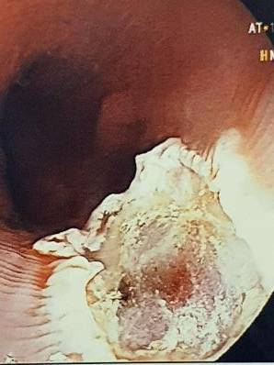
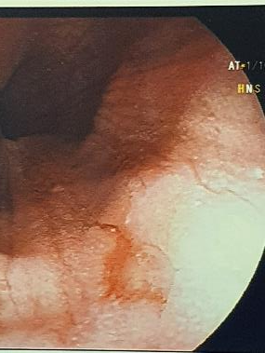
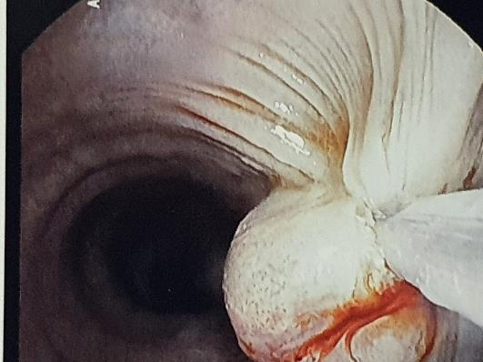
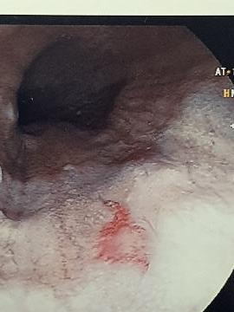
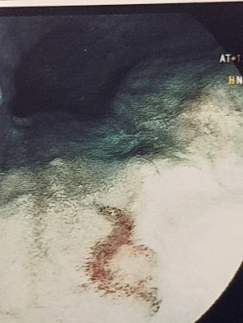
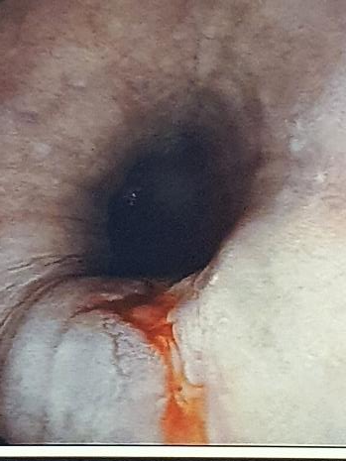
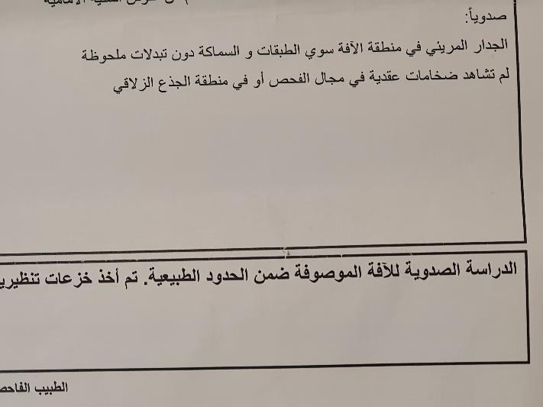
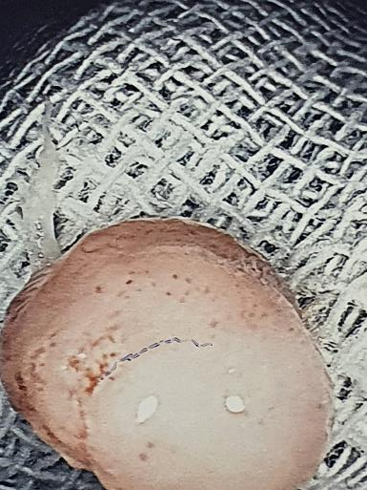
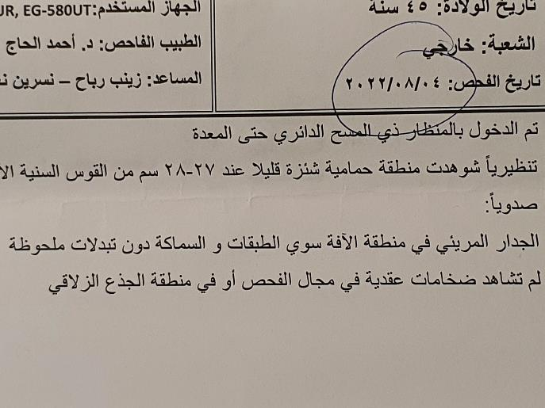
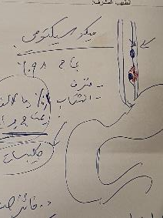
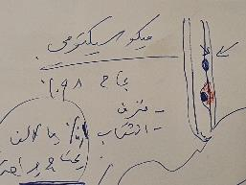
Case -6
34 yo F.
Esophageal Dysphagea
T1 Squamous C Carcinoma
Mycosectomy

Slide 8
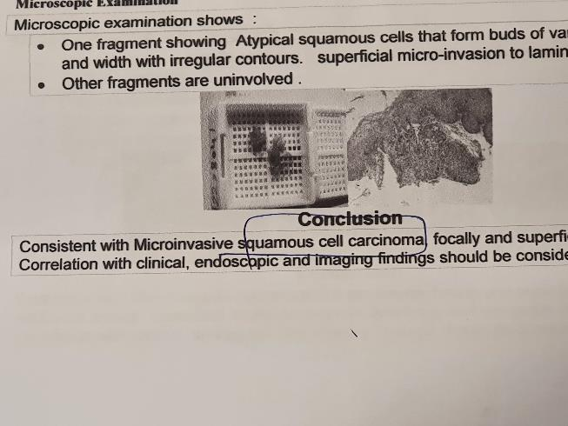
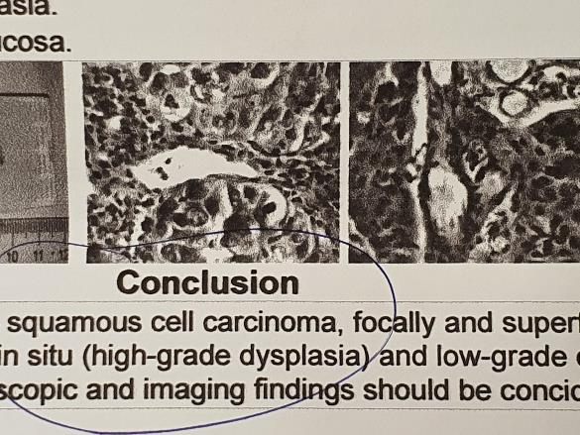
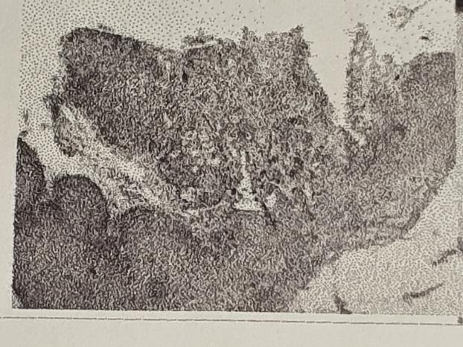

Slide 9
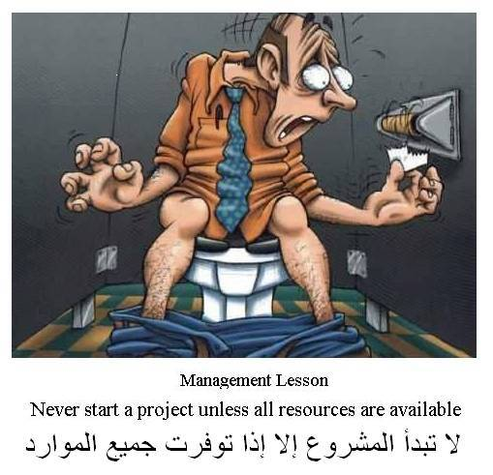
WISDOM
OF
THE DAY

Slide 10
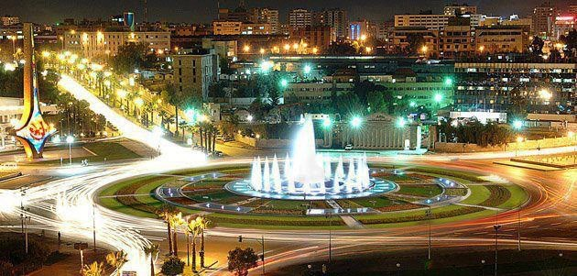
The Beautiful Damascus

Slide 11
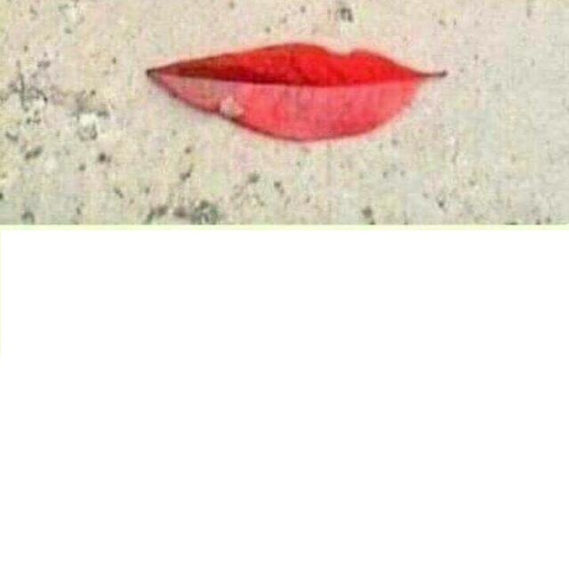
؟
مجردُ ورقةٍ وقعت على الأرضِ
فصنعتْ أجملَ ِابتسامة
Just a leave , fell on ground
And makes the most beautiful smile

Slide 12


Thanks
Fayez

