Slide 1


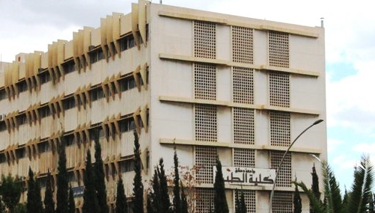
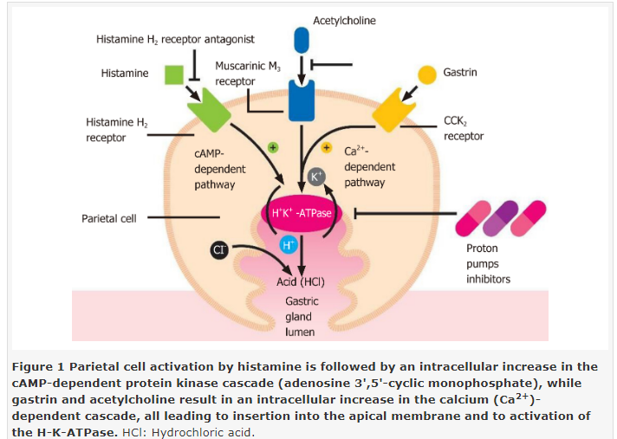
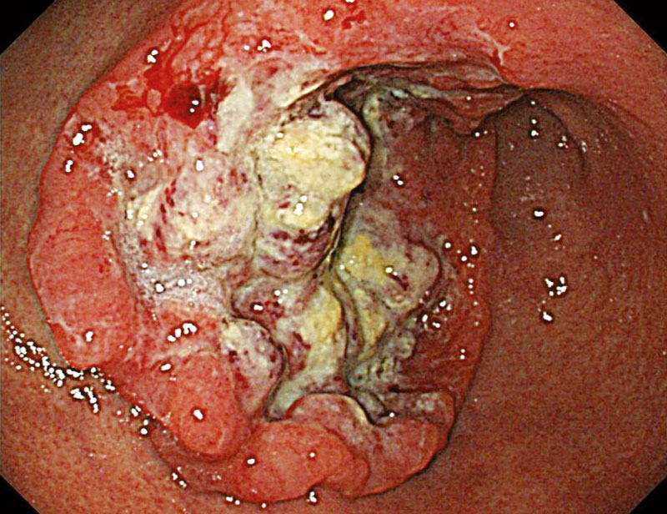
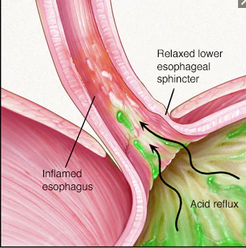
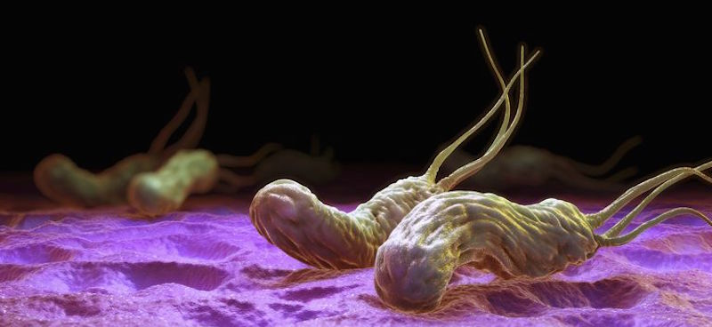
P-CABs and PPIs
Ahmad WASSOUF M.D
Assistant Professor of Gastroenterology
Almouassat University Hospital
Faculty of medicine –Damascus,Syria

Slide 2
Carl Schwartz: 1910
No acid = No ulcer

Slide 3
pH 4 is a critical threshold for gastric pepsin activity
Maximum pepsin activity
(%)
100
80
60
40
20
0
1
2
3
4
Gastric juice pH
Adapted from Berstad 1970
Notes:
89. pH 4 is a critical threshold for gastric pepsin activity
Effective control of intragastric, and hence intraesophageal, pH is essential to prevent the aggressive action of pepsin on the esophageal mucosa.⁶¹ This is because the activity of pepsin in gastric juice is highly pH-dependent, declining rapidly if the pH is raised above 4.^{62,63} Through enhanced delivery to the proton pump, Nexium®, 40 mg once daily, maintains the intragastric pH above 4 for significantly longer than standard doses of all other PPIs.^{5,7–9}
Nexium® thus maintains for longer an environment in which the damaging effects of pepsin will be prevented.
5. Lind T, Rydberg L, Kylebäck A, Jonsson A, Andersson T, Hasselgren G et al. Esomeprazole provides improved acid control vs. omeprazole in patients with symptoms of gastro-oesophageal reflux disease. Aliment Pharmacol Ther 2000;14:861–7.
7. Wilder-Smith C, Claar-Nilsson C, Hasselgren G, Röhss K. Esomeprazole 40 mg provides faster and more effective acid control than rabeprazole 20 mg in patients with symptoms of GERD. J Gastroenterol Hepatol 2002;17 Suppl:A612.
8. Wilder-Smith C, Röhss K, Claar-Nilsson C, Lundin C. Esomeprazole 40 mg provides faster and more effective acid control than lansoprazole 30 mg in patients with symptoms of gastroesophageal reflux disease. Gastroenterology 2002a;122 Suppl 1:A200 (and associated poster).
9. Wilder-Smith C, Röhss K, Lundin C, Rydholm H. Esomeprazole 40 mg provides more effective acid control than pantoprazole 40 mg. J Gastroenterol Hepatol 2002b;17 Suppl:A784.
61. Hunt RH, Cederberg C, Dent J, Halter F, Howden C, Marks IN et al. Optimizing acid suppression for treatment of acid-related diseases. Dig Dis Sci 1995;40 Suppl:24S–49S.
62. Berstad A. A modified hemoglobin substrate method for the estimation of pepsin in gastric juice. Scand J Gastroenterol 1970;5:343–8.
63. Dent J. Roles of gastric acid and pH in the pathogenesis of gastro-oesophageal reflux disease. Scand J Gastroenterol 1994;201:55–61.

Slide 4
Over 25 Years of Proton Pump Inhibitors

Slide 5
Historical view
Proton pump inhibitors (PPIs) were clinically introduced more than 25 years ago and have since proven to be invaluable, safe, and effective agents for the management of a variety of acid-related disorders.
PPIs have demonstrated consistent patient tolerance, excellent safety, and generally superior acid suppressing capability than prior agents.

Slide 6
Mechanism of action
Proton pump inhibitors (PPIs) effectively block gastric acid secretion by irreversibly binding to and inhibiting the hydrogen-potassium ATPase pump that resides on the luminal surface of the parietal cell membrane.

Slide 8
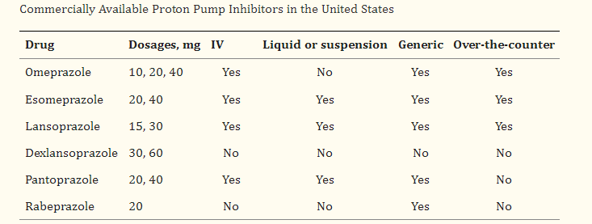
Available PPIs in Market

Slide 9
Which is the most effective PPI?
Although Data comparing the various PPIs showed:
Only small differences between drugs.
Not clinically relevant.
There are different parameters that must be taken into consideration when the available PPIs are compared:
  the average time during which intragastric pH is greater than 4

Slide 10
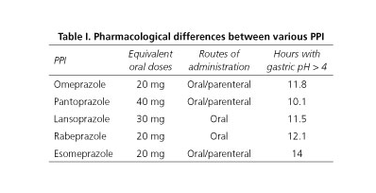

Slide 11
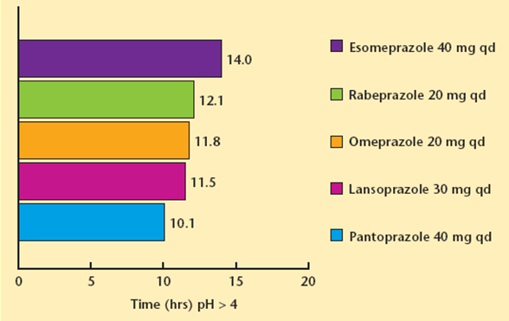
Intragastric pH control in patients with GERD
Gain from 20% to 40% is achieved when comparing
esomeprazole with other PPIs
Katz PO. Rev Gastroenterol Disord. 2003; 3(2): 59 - 69.

Slide 12
Helpful facts on the use of PPIs
Take twice daily for first 2 – 3 days of therapy
Steady state is not reached for a couple of days
First dose should be before breakfast
Second dose, if used, should be before dinner
Not likely to be effective when used as required
Wolfe MM, Sachs G. Gastroenterology 2000; 118: S9 -S31.

Slide 13
Hierarchy of intragastric pH control
PPI once a day
PPI once a day plus H₂RA
PPI bid
PPI bid + H₂RA

Slide 14
Indications for PPI Use

Slide 15
Indications of potent acid inhibition
❶ GERD: need more acid inhibition than PU
❷ Helicobacter Pylori eradication
❸ Peptic ulcer: gastric – duodenal – bleeding PU
 Prevention & treatment of NSAID-induced lesions
❺ Functional Dyspepsia
 ↑Gastric acid : ZES - mastocytosis - retained antrum

Slide 16
Definitely indicated for long-term use (>8 wk)
Barrett’s esophagus
Clinically significant (LA Classification grade C/D) erosive esophagitis
Esophageal strictures from GERD (ie, peptic strictures)
Zollinger-Ellison syndrome

Slide 17
Definitely indicated for long-term use (>8 wk)
Eosinophilic esophagitis
Gastroprotection in users of ASA/nonsteroidal anti-inflammatory drug at high risk for GI bleeding
Prevention of progression of idiopathic pulmonary fibrosis

Slide 18
Definitely indicated for acute/short-term use (≤8 wk)
Helicobacter pylori eradication
Stress ulcer prophylaxis for ICU patients with risk factors
Uninvestigated GERD/dyspepsia
Treatment of NSAID-related gastric and duodenal peptic ulcers

Slide 19
Not indicated for acute/short-term use
Empiric treatment of laryngopharyngeal symptomatology
Acute undifferentiated abdominal pain
Acute nausea and vomiting not believed to be related to GERD/esophagitis
Any isolated lower GI symptomatolog

Slide 20
❶ PPIs & GERD

Slide 21
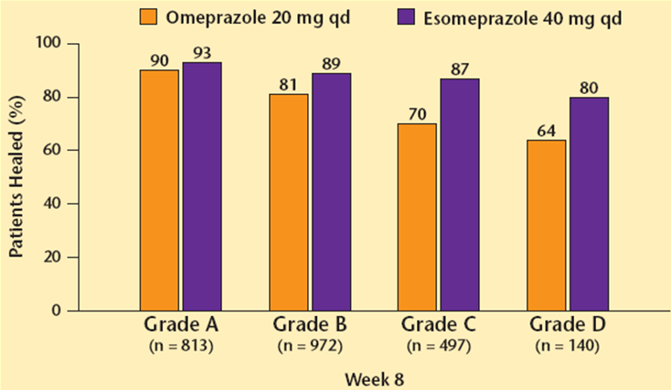
Healing rates of erosive esophagitis according to LA Grade
P = 0.001
Richter et al. Am J Gastroenterol 2001; 96 : 656 – 665.

Slide 22
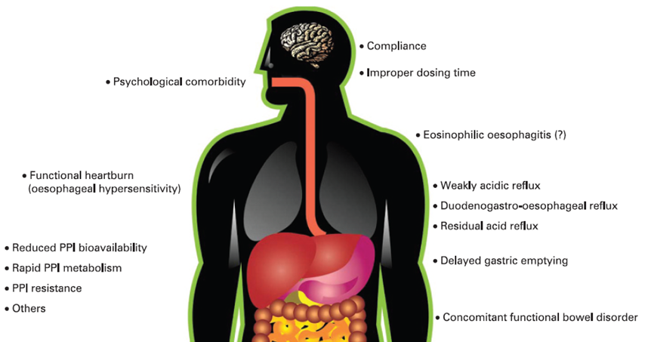
Underlying mechanisms for persistent heartburn despite treatment with PPIs
10 – 40 % of patients
Fass R & Sifrim D. Gut 2009 ; 58 : 295 – 309.
Notes:
It has been estimated that between 10% and 40% of patients with gastro-oeophageal reflux disease(GORD) fail to respond symptomatically, either partially or completely, to a standard dose proton pump inhibitor.
What constitutes refractory GORD remains an area of controversy.
Most investigators believe that only patients with GORD who exhibit partial or lack of response to PPIs twice daily should be considered as PPI failures.
Other potential underlying mechanisms, such as reduced PPI bioavailability, rapid PPI metabolism and, specifically, mutations in the 2C19 isoform of cytochrome p450, PPI resistance, and Helicobacter pylori status have all been shown to play a limited role in PPI failure. Pill-induced oesophagitis, skin diseases with oesophageal involvement, Zollinger–Ellison syndrome, and achalasia are very unusual causes for PPI failure and are rarely confused with
GORD alone.

Slide 23
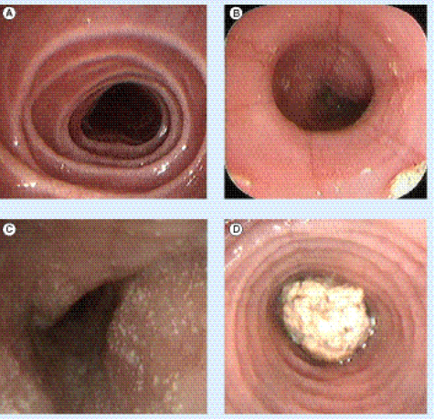
Endoscopic images of eosinophilic esophagitis

Slide 24
❷ PPIs & HP eradication

Slide 25
PPI & HP eradication
Single dose of PPIs reduces efficacy of HP eradication
PPIs should be used at double the standard doses
Exception of esomeprazole: 20mg bid is effective
No data available that might suggest one PPI to be
preferable to another in this indication

Slide 26
❸ PPIs & peptic ulcers:
Gastric – duodenal – bleeding

Slide 27
Medical therapy for gatric & duodenal ulcer
Removing injurious agent: NSAIDs or HP
Standard dose of PPI suffices
Double dose in some cases particularly in gastric ulcer
No comparative studies between various PPIs

Slide 28
Forrest’s classification for PU bleeding
Stage | Characteristics | Rebleeding
I a | Jet arterial bleeding | 90 %
Ib | Oozing | 50 %
IIa | Visible Vessel | 25 – 30 %
IIb | Adherent clot | 10 – 20%
IIc | Black spot in ulcer crater | 7 – 10%
III | Clean base ulcer | 3 – 5 %

Slide 29
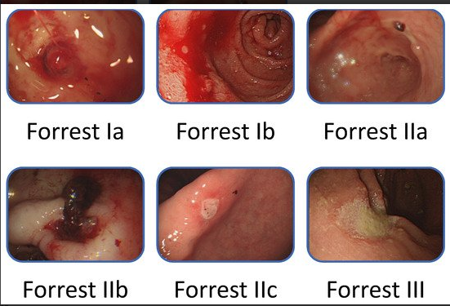
Forrest’s classification for bleeding PU

Slide 30
PPI & bleeding PU
Consensus recommendations*
Initially 80 mg bolus
Followed by Infusion of 8 mg/hr for 72 hrs
After 72 h Equivalent to omeprazole 40 mg bid
if oral intake is resumed
Controversial issues**
Dose No uniform consensus
Route Omeprazole 40 mg bid PO effective***
* Barkun A et al. Ann Intern Med 2003 ;139 : 843 – 57.
** Leontiadis GI et al. Gastroenterol Clin N Am 2009 ; 38 : 199 – 213.
*** Kaviani MJ et al. Aliment Pharmacol Ther 2003 ; 17 : 211 – 6.
Notes:
Pre-endoscopic administration of PPIs in patients with nonvariceal upper GI bleeding is still of controversial efficacy.
The optimal dose and route of PPI administration has yet to be determined.

Slide 31
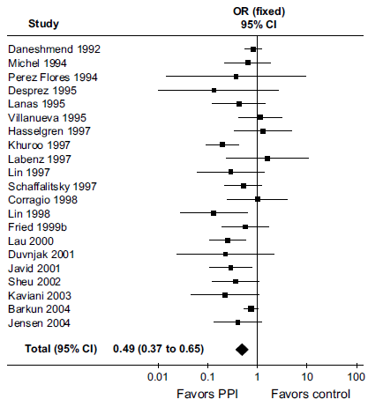
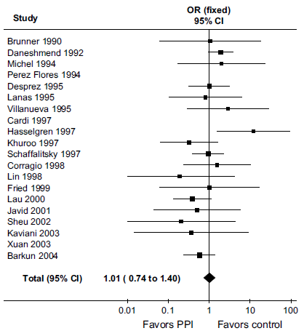
PPIs in peptic ulcer bleeding
24 RCTs – 4373 patients included
Rebleeding – NNT 13
Mortality
Leontiadis GI et al. Cochrane Database Syst Rev 2006;(1):CD002094.
Notes:
Rebleeding
The reduction of 30-day rebleeding rates remained statistically significant in all predetermined subgroup analyses. That is, PPIs significantly reduced rebleeding independent of methodological quality of the trials, severity of baseline endoscopic signs of recent hemorrhage, type of control treatment (placebo or H2RA), geographic location of the trials (conducted in Asia or elsewhere), mode of PPI administration (oral or intravenous), dose of PPI (high-dose defined as at least 80 mg bolus followed by an intravenous infusion of 8 mg/h for 72 hours; low-dose defined as any lesser dose intravenous or oral), and whether or not endoscopic hemostatic treatment was given.
Other outcomes:
Surgical interventions were significantly less common with PPI treatment (6.1%) than with control treatment (9.3%); OR 0.61, 95% CI 0.48–0.78; NNT 34, 95% CI 20–50. Further endoscopic hemostatic treatment (after randomization) was also reduced with PPIs (5.6%) compared with control treatment (15.7%); OR 0.32, 95% CI0.20–0.51; NNT 10, 95% CI 8–17.
Mortality
Despite the beneficial effect of PPI treatment on the above outcomes, there was no evidence of an effect on all-cause mortality rates (OR 1.01, 95% CI 0.74–1.40).
PPIs significantly reduced mortality among trials that had been conducted in Asia (OR 0.35, 95% CI 0.16–0.74; NNT 34, 95% CI 20–100), but had no verifiable effect among trials that had been conducted elsewhere (OR 1.36, 95% CI 0.94–1.96). Similarly to the outcome of rebleeding, a higher treatment effect of PPIs in Asian trials was confirmed by metaregression.
There have been three other published meta-analyses of RCTs that have assessed the role of PPIs in peptic ulcer bleeding. The most consistent finding of these meta-analyses, which is also in agreement with the Cochrane meta-analysis, is that PPIs compared with H2RAs or placebo significantly reduce rebleeding rates in patients with peptic ulcer bleeding.

Slide 32
 PPIs & NSAIDs

Slide 33
NSAID-related GI side effects
Serious GI Events
Relative Severity
Clinical Ulcers
Endoscopic Ulcers
GI Symptoms
Relative Frequency
Notes:
37

Slide 34
Patients at increased risk for NSAIDs GI toxicity
High risk | 1. History of complicated ulcer especially recent 2. Multiple (> 2 risk factors)
Moderate risk (1 – 2 risk factors) | 1. Age > 65 years (OR 2.0 – 3.5) 2. High dose NSAID therapy (OR 8.0) 3. Previous history of uncomplicated ulcer 4. Concurrent use of aspirin 5. Concurrent use of corticosteroids (OR 2.0) 6. Concurrent use of anticoagulants (OR 3.0)
Low risk | No risk factors
HP is independent & additive risk factor & addressed separately
ACG guidelines for prevention of NSAID-related ulcer complications .
Am J Gastroenterol 2009 ; 104: 728 – 738.

Slide 35
 PPIs & dyspepsia

Slide 36
Functional dyspepsia
Persistent or recurrent pain or discomfort centered in the
upper abdomen for more than 12 weeks in the preceding
12 months with no evidence of an organic disease that is
likely to explain the symptoms
Divided into 4 symptom groups: Ulcer-like
Reflux-like
Dysmotility-like
Unspecified

Slide 37
Alarm features in dyspepsia (red flags)

Age > 55 years with new-onset dyspepsia
Family history of UGI cancer
Unintended weight loss
Gastrointestinal bleeding
Progressive dysphagia or odynophagia
Unexplained iron-deficiency anemia
Persistent vomiting
Palpable mass or lymphadenopathy
Jaundice
AGA technical review on evaluation of dyspepsia.
Gastroenterology 2005 ; 129 : 1756 – 80.

Slide 38
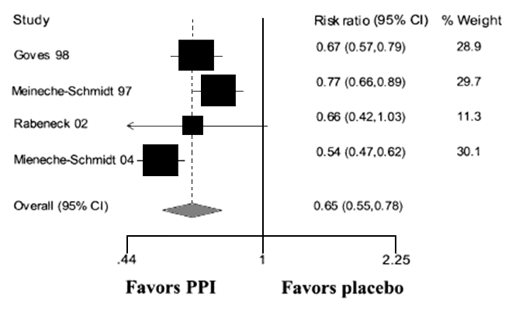
PPI versus placebo in uninvestigated dyspepsia
MA of 4 RCTs
AGA technical review on evaluation of dyspepsia.
Gastroenterology 2005 ; 129 : 1756 - 80.

Slide 39
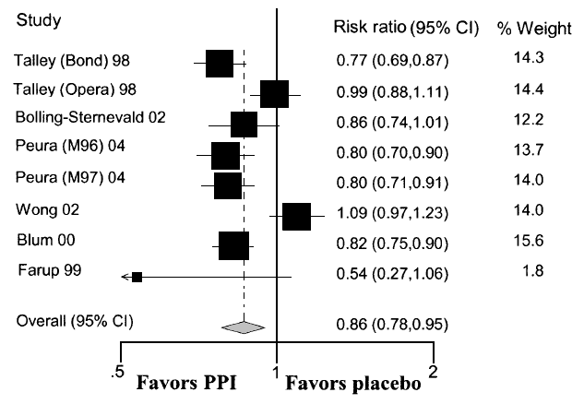
PPI versus placebo in nonulcer dyspepsia
8 RCTs
AGA technical review on evaluation of dyspepsia.
Gastroenterology 2005 ; 129 : 1756 - 80.

Slide 40
 PPIs & Zollinger-Ellison syndrome

Slide 41
Suspicion of ZES
Refractory erosive esophagitis
Multiple peptic ulcers
Ulcers in distal duodenum or jejunum
Complicated ulcers
Recurrent ulcers after acid-reducing surgery
Ulcers associated with diarrhea
Family history of MEN-1

Slide 42
Treatment of ZES
Surgery Gastrinoma enucleation
Parietal cell vagotomy
Total gastrectomy (abandoned)
PPI Control acid secretion in most patients
Very high doses (eg, omeprazole 120mg/day)
Schubert ML & Peura D A. Gastroenterology 2008 ; 134 : 1842 – 1860.

Slide 43
Overprescribing PPIs
In a series of hospital inpatients in Michigan, USA
On admission 20% of patients taking PPI
During hospital stay Another 40% were prescribed PPI
Mostly for prophylaxis
At discharge 50% of patients taking PPIs
90% of patients did not need PPIs
PPIs are clearly being overused
Ann Pharmacother 2006 ; 40 : 1261 – 6.

Slide 44
Overprescribing PPIs
2006 Expenditure on PPIs in England £425m
Expenditure on PPIs in the world £7bn
25-70% of pts taking PPIs have no appropriate indication
Money spent unnecessarily on PPIs each year
England at least £100m
Worldwide at least £2bn
Bruzzi P. BMJ 2008 ; 336 : 2 – 3.

Slide 45
What dose of PPIs?
Generic name | Standard dose (mg/day) | Refractory patient (mg/day)
Omeprazole | 20 mg | 80 mg
Lanzoprazole | 30 mg | 120 mg
Pantoprazole | 40mg | 160 mg
Rabeprazole | 20 mg | 80 mg
Esomeprazole* | 40 mg | 80 mg
* Therapeutic advantage of esomeprazole, which is less relevant
in overall population, might be of more interest in refractory one

Slide 46
PPI dose adjustment
Renal failure No repercussion on PPI elimination
No need to adjust dosage
Liver failure Half-life increases to 4 – 8 h (nl: 1 h)
Reduction of dosage
Aged patients No dosage adjustment usually
Adjustment if hepatic or renal failure
is added to advanced age
Drugs 2005; 65 Suppl. 1

Slide 47
For how long?
Indication | Duration
GERD | Indefinite period of time or use on demand
HP eradication | 7 – 10 – 14 days
Duodenal ulcer | 4 wks – duration increased in refractory cases
Gastric ulcer | 8 wks – duration increased in refractory cases
Bleeding PU | IV PPIs for 72 hours (consensus)
Gastroprotection | As long as patient requires NSAIDs or ASA
Dyspepsia | Depend on symptomatic response
ZES | Indefinite period of time
Notes:
Bleeding peptic ulcer:
Proton pump inhibitors have been shown to be effective in the management of upper digestive tract bleeding in patients with lesions at high risk of re-bleeding, either as the only treatment or in association with local haemostatic procedures. Although it has been demonstrated, in undeveloped countries, that even the oral route is effective (omeprazole 40mg twice daily), in our environment patients at high risk of re-bleeding are provided with a venous access; until oral intake can be resumed, the drug should be administered as a continuous infusion. In Spain, both omeprazole and pantoprazole are available for intravenous use. Both omeprazole and pantoprazole
are given as an initial 80mg bolus, followed by continuous infusion at a rate of 8 mg/h, although there is no uniform consensus as to the dose. After 72 h, and when the patient has resumed oral intake, it is probably advisable to maintain a dosage equivalent to omeprazole 40mg twice daily by mouth.

Slide 48
Which PPIs?
◆ Efficacy
Esomeprazole (40mg/d) slightly more effective
Useful in refractory ulcer
Useful in difficult GERD: extent of lesion – Barrett’s
❖ Interactions with other drugs
Less interaction in rabeprazole & especially pantoprazole
Clinical relevance probably minimal
Dose adjustment in AVK, benzodiazepines, phenytoin
⬥ Cost considerations
Notes:
The effects of drugs of the same pharmacological group are mostly ‘class’ or ‘group’ effects
Thus all statins would have similar clinical usefulness, & all ACE inhibitors would be equally useful in management of HTN.
It is not scientifically valid to assume that this is always the case.
For instance, it was necessary to withdraw cerivastatin from the market because of a greater frequency of rhabdomyolysis,
which was detected only during postmarketing surveillance, & it has recently been suggested that the effect of ramipril on mortality in
heart failure might be greater than that of other ACE inhibitors.
Scientifically valid conclusions should be based on head-to-head comparative trials between the various drugs. However, as the
demonstration of differences may be quite expensive (long-term trials with large study populations), smaller studies are usually carried out, the clinical relevance of which is quite debatable. Even more to the point: all too often, equivalence studies are accepted as valid while being methodologically clearly inadequate.
The concept of bioequivalence is important because these drugs are highly labile in an acid environment and are rapidly degraded if
released in the stomach. the effect of a given preparation depends, not only on the amount of the active molecule contained in the capsule or tablet, but at least as much on the quality and stability of the enteric coating protecting the active molecule.
The potency of these bioequivalence studies is all too often debatable.

Slide 49
PPIs limitations
Poor compliance (50% of patients do not take their PPIs within 1 hour of breakfast).
A number of efforts have been made to overcome the inherent pharmacologic limitations of currently available PPIs

Slide 50
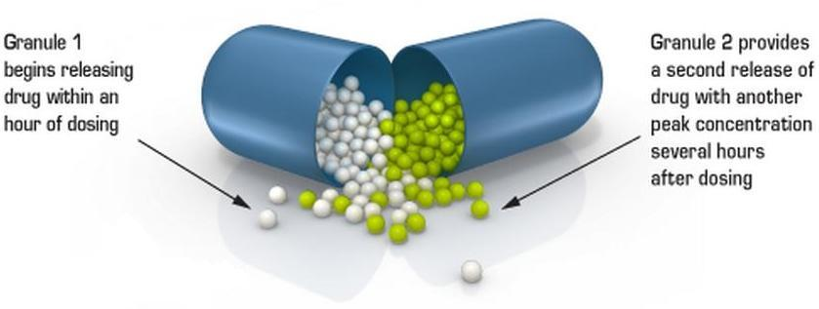
A Dual Delayed
Release Capsule
Dexlansoprazole 30 – 60 mg
One Dexlansoprazole capsule … Two releases
The Dual Delayed Release (DDR) formulation contains 2 types of
enteric-coated granules

Slide 51
Dexlansoprazole is the R-enantiomer of lansoprazole (a racemic (50:50) mixture of the R- and S-enantiomers)
Dual-release dexlansoprazole is formulated to release drug in two separate pH controlled phases.
First release 25% of the drug dose is liberated in the proximal small intestine at a pH of 5.5, with pharmacokinetics (peak plasma concentration of 1 to 2 hours) similar to traditional enteric coated PPIs.
second release of 75% of the drug dose in the more distal small intestine at a pH of 6.75 which provides a second serum peak at 5 to 6 hours after administration.

Slide 52
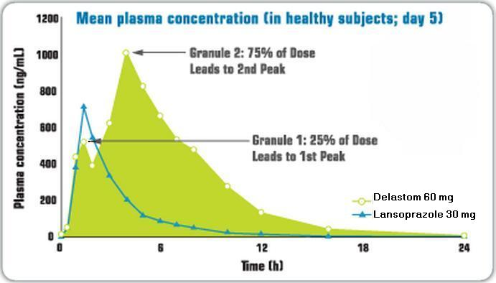
Dexlansoprazole works a second shift to help shut down acid pumps
Randomized, open-label, multiple-dose, crossover study (n=40) evaluating DELASTOM 60 mg and lansoprazole 30 mg once daily for 5 days in healthy subjects
Dexlansoprazole is the first and only PPI that works with a Dual Delayed Release (DDR) formulation, which provides a second release of drug
Notes:
Randomized, open-label, multiple-dose, crossover study (n=40) evaluating DELASTOM 60 mg and lansoprazole 30 mg once daily for 5 days in healthy subjects

Slide 53
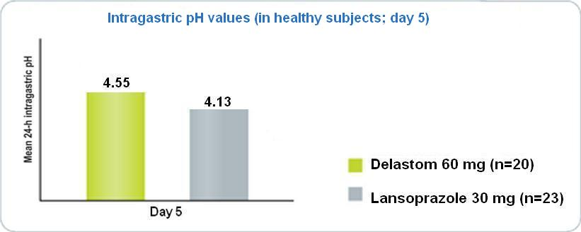
Dexlansoprazole maintains intra gastric pH >4
Efficacy
p<0.001
Dexlansoprazole higher mean 24-h intra gastric pH values
vs. lansoprazole
Notes:
On day (5), Delastom maintained pH > 4 for 18% more time than lansoprazole did (P < 0.01).

Slide 54
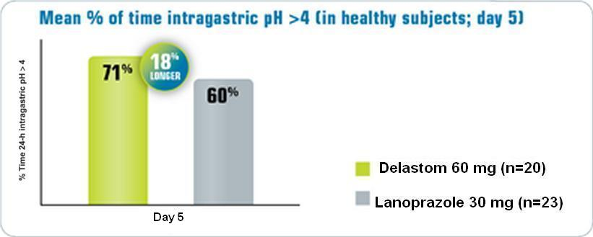
Dexlansoprazole maintains intra gastric pH >4
Efficacy
The percentage of time intragastric pH > 4 over a 24-h period post-dose has become the benchmark for predicting clinical efficacy of PPIs in the treatment of acid-related disorders.
P < 0.01
Dexlansoprazole … 18% extra time maintains intragastric pH >4 vs lansoprazole
Notes:
On day (5), Delastom maintained pH > 4 for 18% more time than lansoprazole did (P < 0.01).
(4). Bell NJV, Burger D, Howden CW, Wilkinson J, Hunt RH. Appropriate acid suppression for the management of gastro-oesophageal reflux disease. Digestion 1992; 51: 59–67

Slide 55
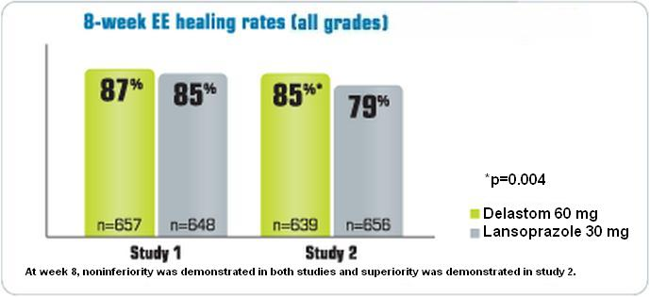
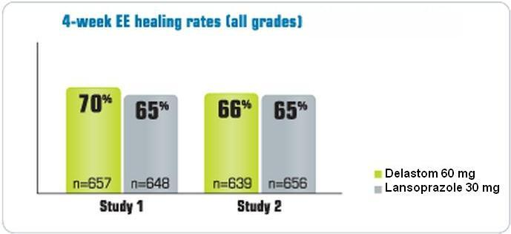
Efficacy
Results of 2 multicenter, double-blind, active-controlled, randomized, 8-week studies in patients with endoscopically confirmed EE.
Results of multicenter, double-blind, active-controlled, randomized, 8-week studies in patients with endoscopically confirmed EE.
Healing at 4 weeks
Healing at 8 weeks
At week 8, Superiority of Dexlansoprazole vs. lansoprazole was demonstrated in the study
Notes:
non inferiority عدم النقص

Slide 56

Efficacy
Dexlansoprazole is indicated for healing all grades of erosive esophagitis (EE)
with a recommended dose of
Dexlansoprazole 60 mg once daily for up to 8 weeks

Slide 57
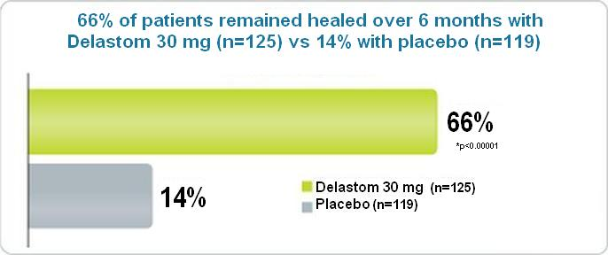
Efficacy
Results of a 6-month, multicenter, double-blind, placebo-controlled, randomized study of patients who had successfully completed an EE study and showed endoscopically confirmed healed EE.
Dexlansoprazole provides effective maintenance of EE healing and heartburn relief
Notes:
As EO is a chronic, relapsing disease, there is a need for effective long-term maintenance therapy in most
patients.

Slide 58
Efficacy
Dexlansoprazole is indicated for maintaining healing of Erosive Esophagitis and heartburn relief
with a recommended dose of
Dexlansoprazole 30mg once daily for up to 6 months

Slide 59
Dosing
PPI | Administration
Dexlansoprazole | with or without food
Lansoprazole | before eating
Esomeprazole
Omeprazole
DELASTOM offers dosing flexibility, regardless of food.

Slide 60
The first and only PPI that works with a Dual Delayed Release (DDR)
Prolonged therapeutic potency with extra clinical efficacy in controlling pH
Dosing flexibility, regardless of meals.
No evidence of overall differences in safety or efficacy observed between elderly and younger adult patients
No dosage adjustment required for renal dysfunction
Pregnancy Category: B

Slide 61
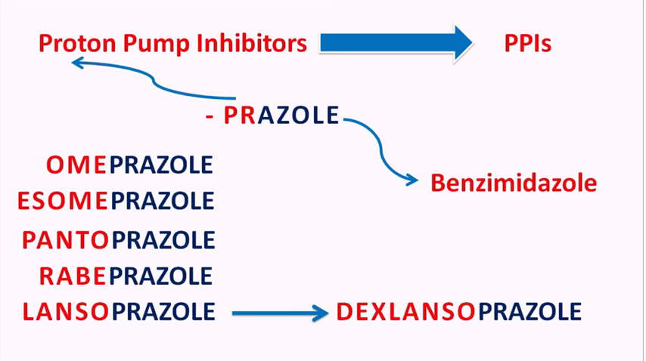

Slide 62
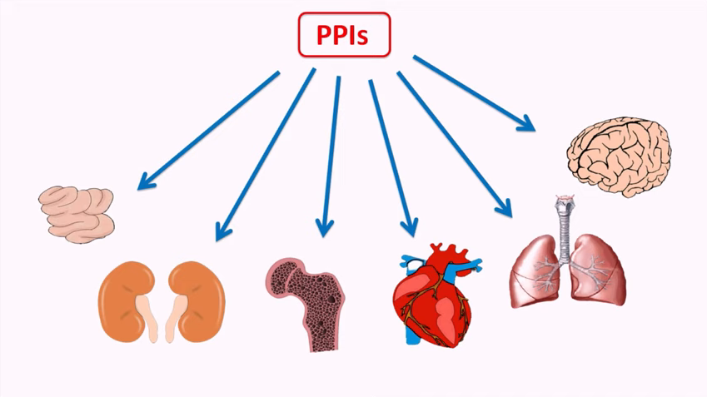

Slide 63
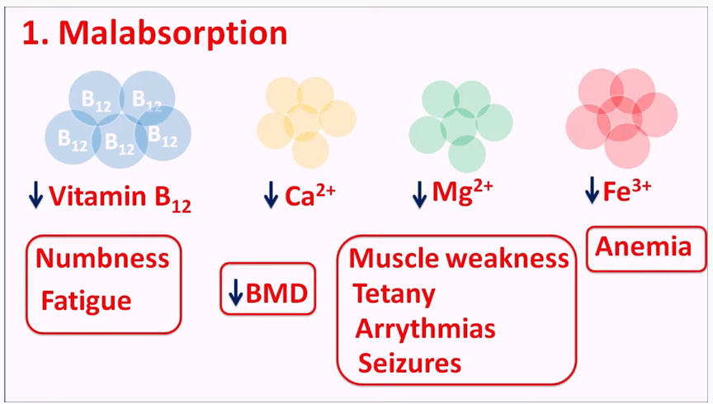

Slide 64
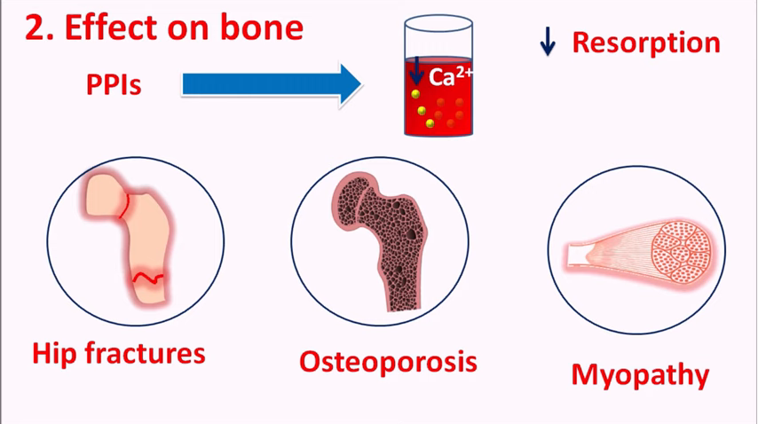

Slide 65
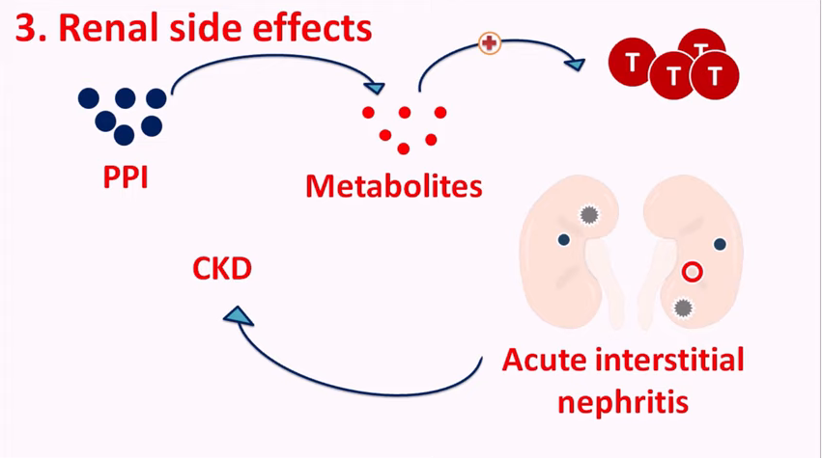

Slide 66
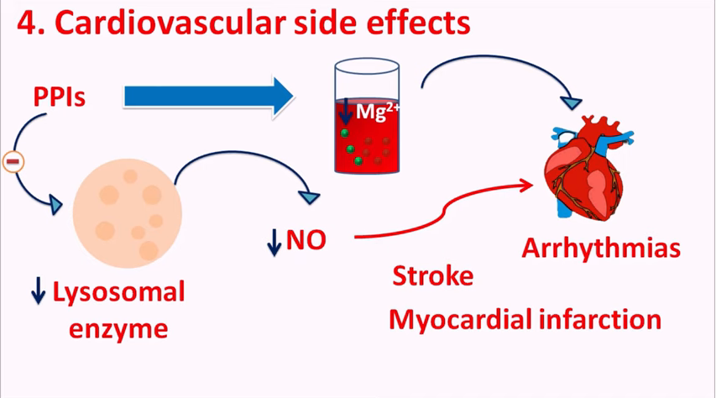

Slide 67
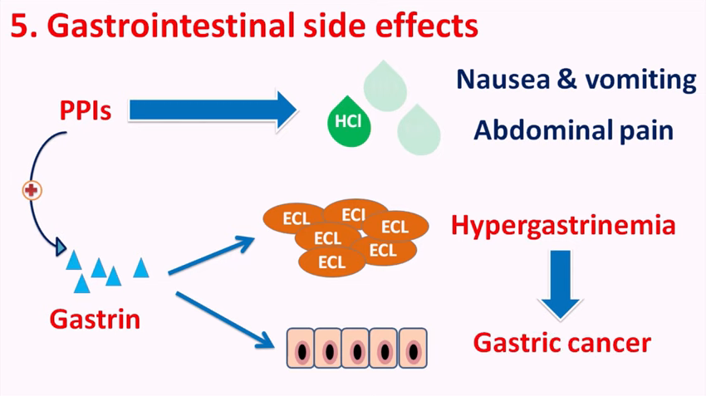

Slide 68
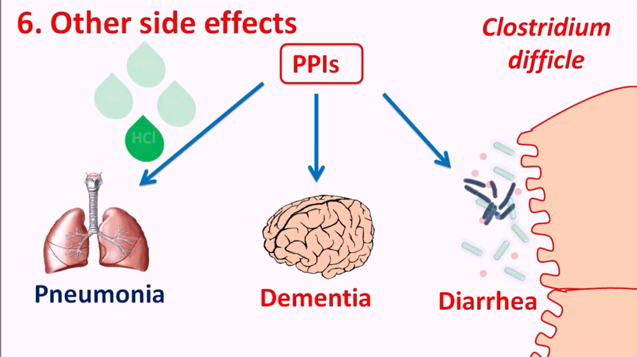

Slide 69
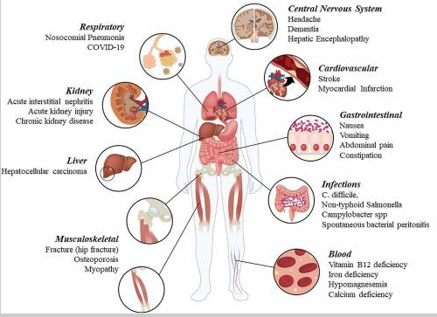

Slide 70
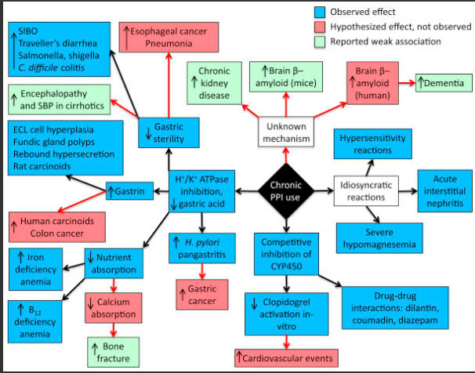

Slide 71
Conclusion
Prescribing PPIs
The lowest effective dose
of the cheapest drug
for the shortest possible time

Slide 72
Potassium-competitive acid blockers
are they the next generation of proton pump inhibitors?

Slide 73
Mechanism of action
P CABs bind reversibly to K⁺ ions and block the H⁺, K⁺ ATPase enzyme, thus preventing acid production.
(P-CABs) inhibit the proton pump but at a different site and through a different mechanism of action than proton pump inhibitors (PPIs).
P-CABs interact with the potassium channel adjacent to the proton pump. They bind ionically, unlike PPIs, which bind covalently. This means that the binding action of P-CABs is potentially reversible. These agents have a faster onset of action than PPIs, and they have a more sustained action in inhibiting acid secretion.

Slide 74
Mechanism of action
P CABs bind ionically, unlike PPIs, which bind covalently. This means that the binding action of P-CABs is potentially reversible.
These agents have a faster onset of action than PPIs, and they have a more sustained action in inhibiting acid secretion.

Slide 75
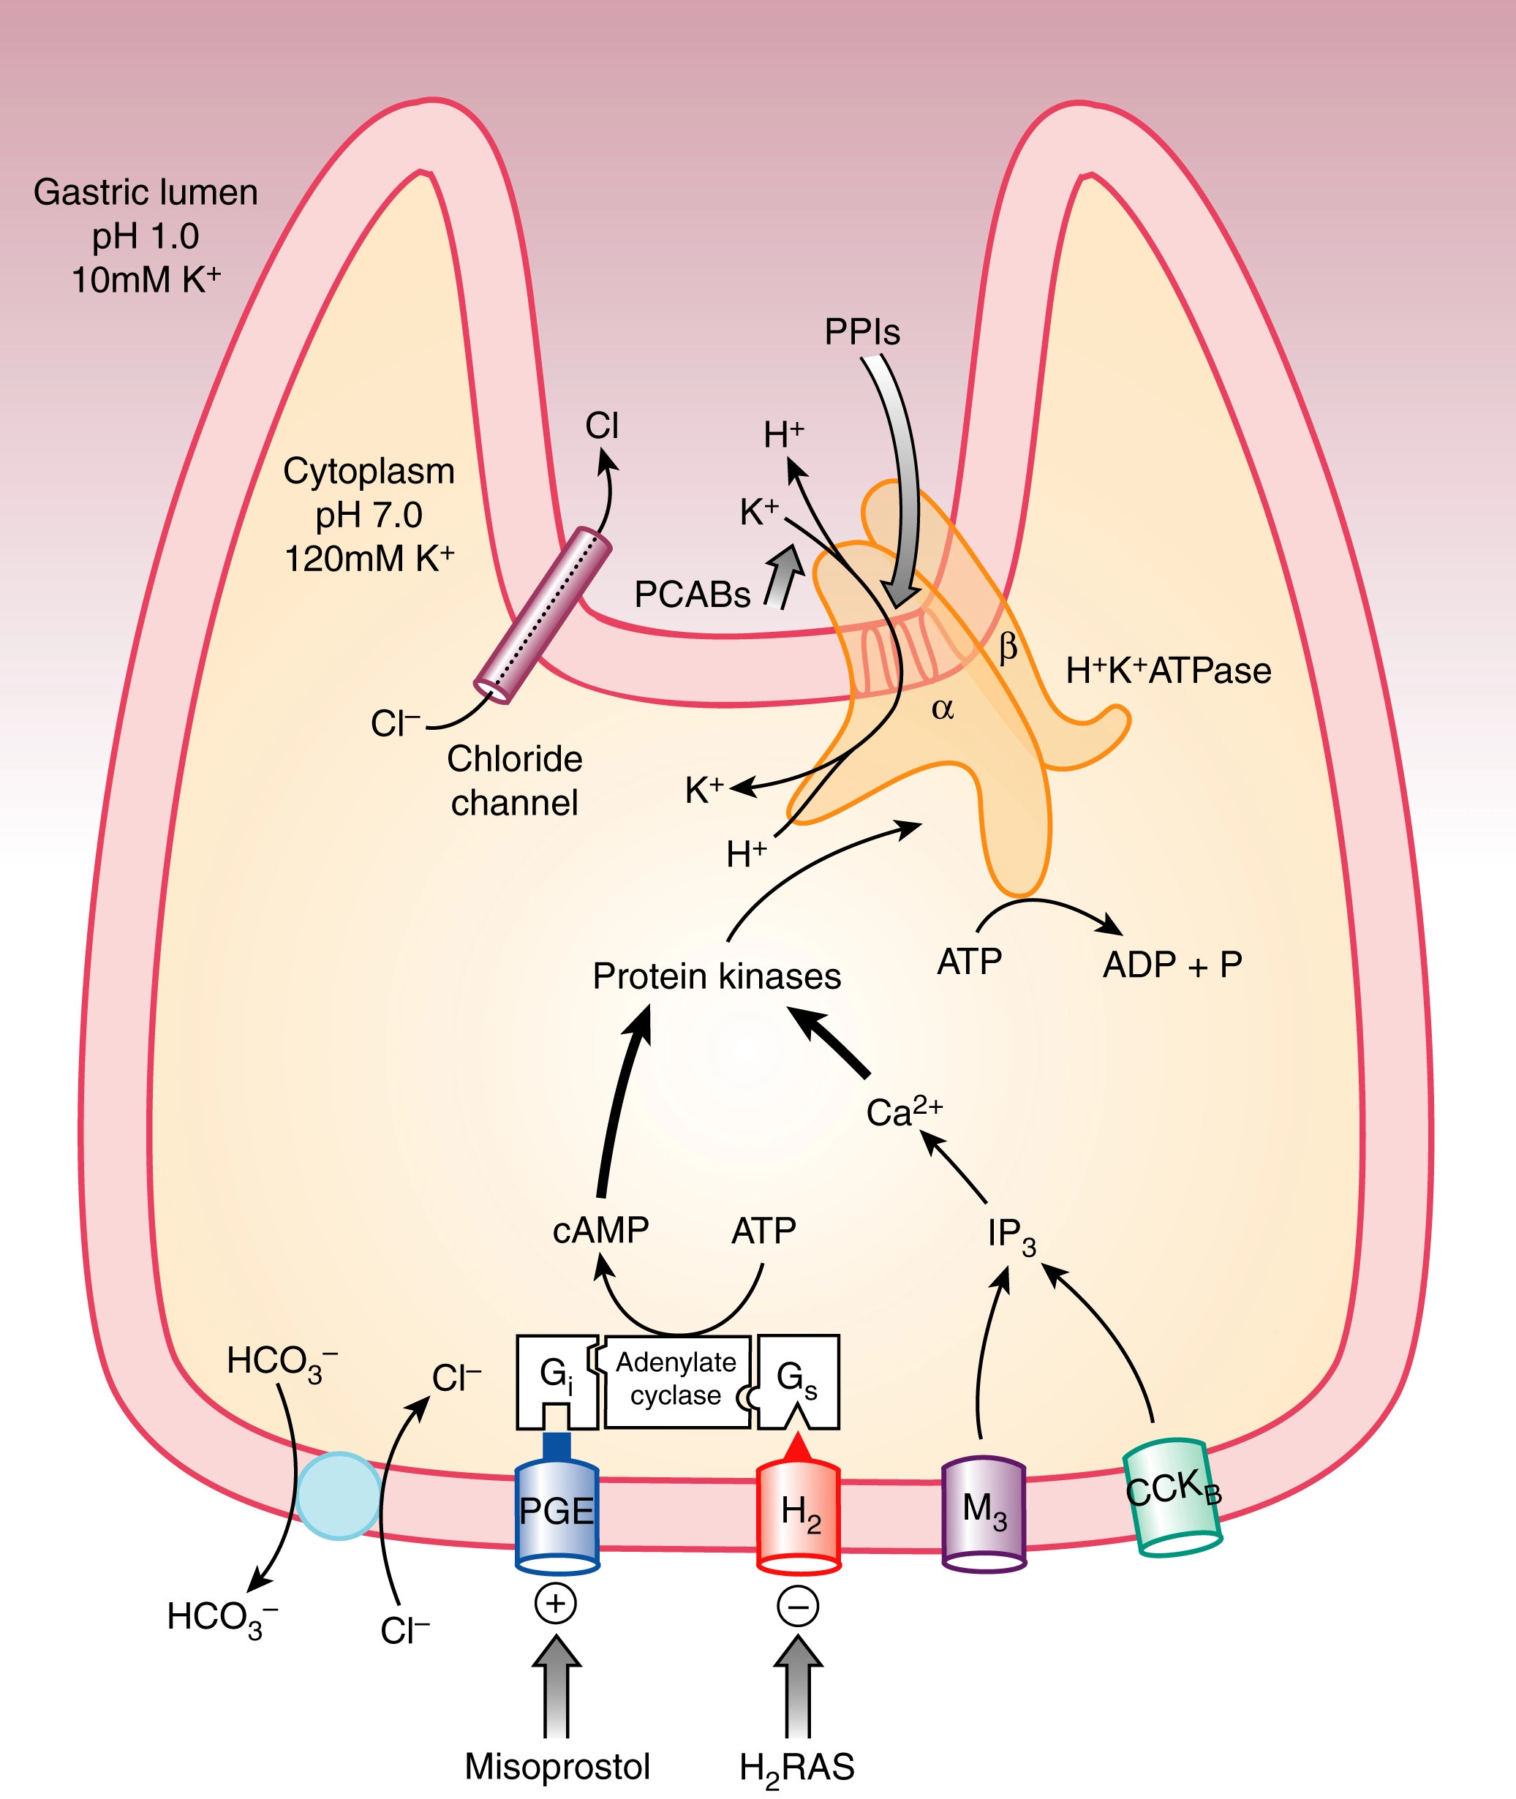

Slide 76
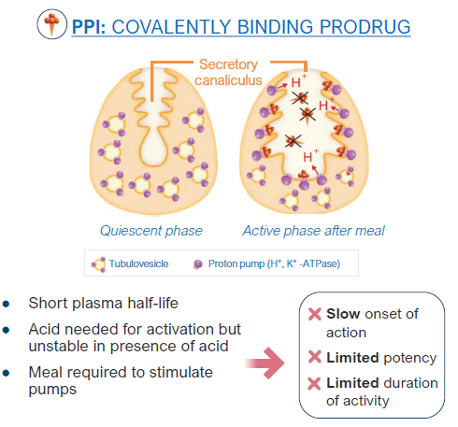

Slide 77
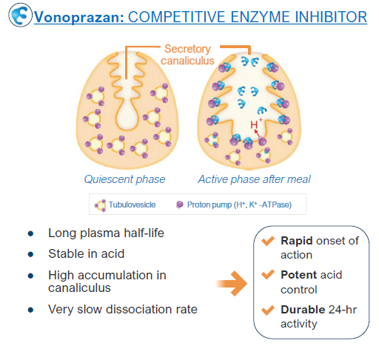

Slide 78
Historical view
Potassium-competitive acid blockers (P-CABs) are a group of drugs developed in the early 1980s.
The first drug developed was stopped due to its toxic effects on the liver
Another drug was developed, was potent but a reversible inhibitor of H⁺, K⁺ ATPase with a rapid onset of action. In phase II and III trials, this drug displayed similar efficacy to esomeprazole for treating esophagitis and for symptomatic relief of nonerosive reflux disease (NERD); however further trials could not be conducted on this drug, as it was not superior to esomeprazole, and there was an adverse drug reaction, hepatotoxicity with reversible elevation of hepatic transaminases

Slide 79
Historical view
The first P-CAB used in clinical practice was revaprazan, marketed in South Korea. Like other P-CABs, it had a quick action onset, however, was not superior to the existing proton pump inhibitors.
The second P-CAB introduced in clinical practice was vonoprazan fumarate marketed in Japan in early 2015; it became popular because of its superior properties such as rapid onset of action, long duration of action, and potent acid suppression compared to the traditional PPIs.

Slide 80
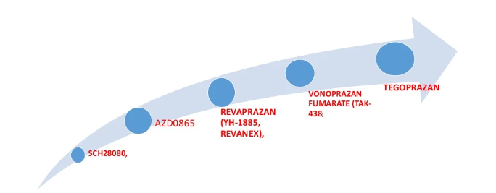
Historical view
Tegoprazan was approved for the treatement of erosive esophagitis and NERD in south Korea in July 2018

Slide 81
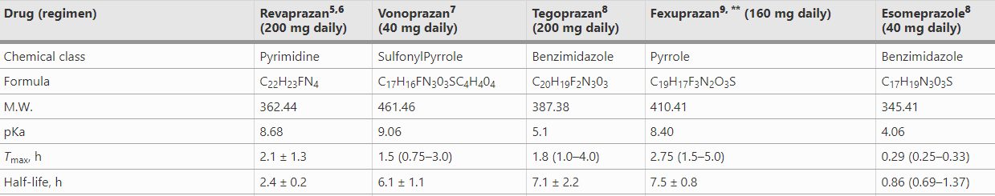

Slide 82
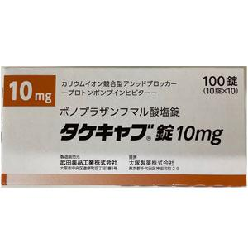
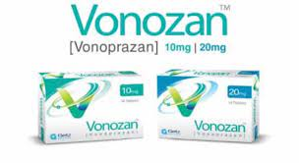
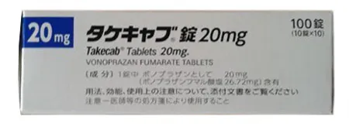
Vonoprazan
Japan
Pakistan

Slide 83

May 25, 2022
Phathom Pharmaceuticals Announces FDA Acceptance for Filing of Vonoprazan for the Treatment of Erosive Esophagitis.

Slide 84
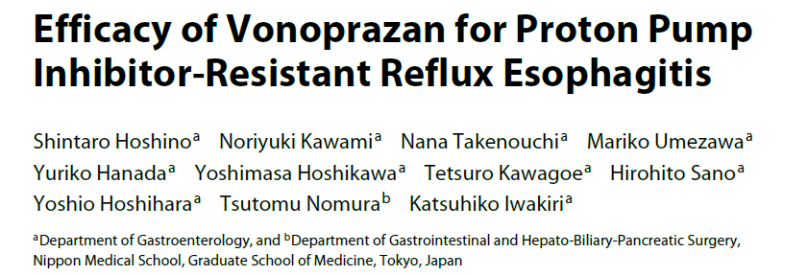
In 21 (87.5%) out of 24 patients, esophageal mucosal breaks were successfully treated by 20 mg VPZ.
The median FSSG score was significantly lower on days 1–7, 14, and 28 after the initiation of VPZ

Slide 85
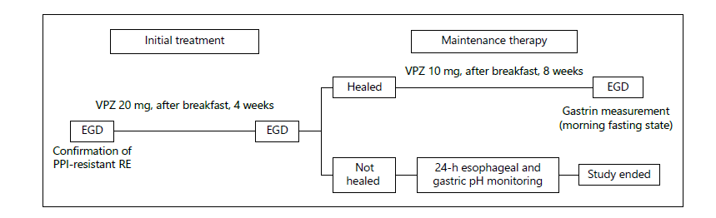

Slide 86
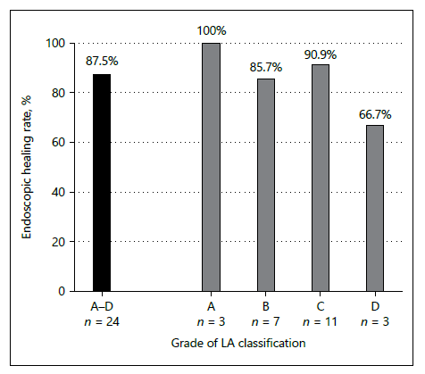

Slide 87
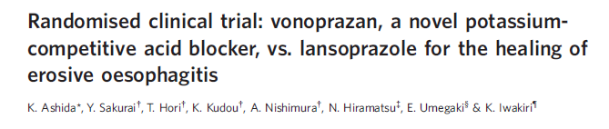
The non-inferiority of vonoprazan to lansoprazole in EE was verified in the comparison study, and vonoprazan was well-tolerated and effective during the long-term maintenance study.

Slide 88
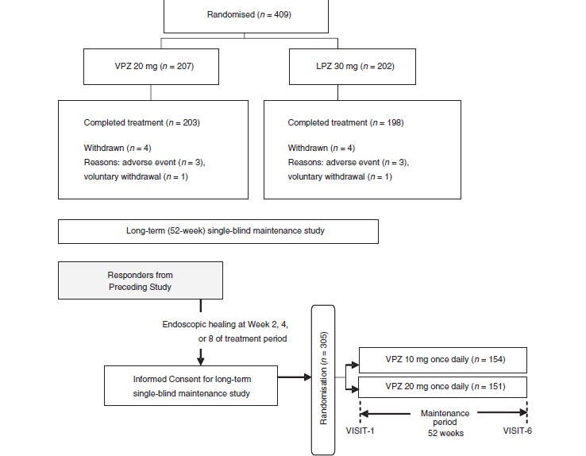

Slide 90

was a randomized, double-blind, two-phase, multicenter, Phase 3 trial that enrolled 1,024 patients with EE in the U.S. and Europe.

Slide 91
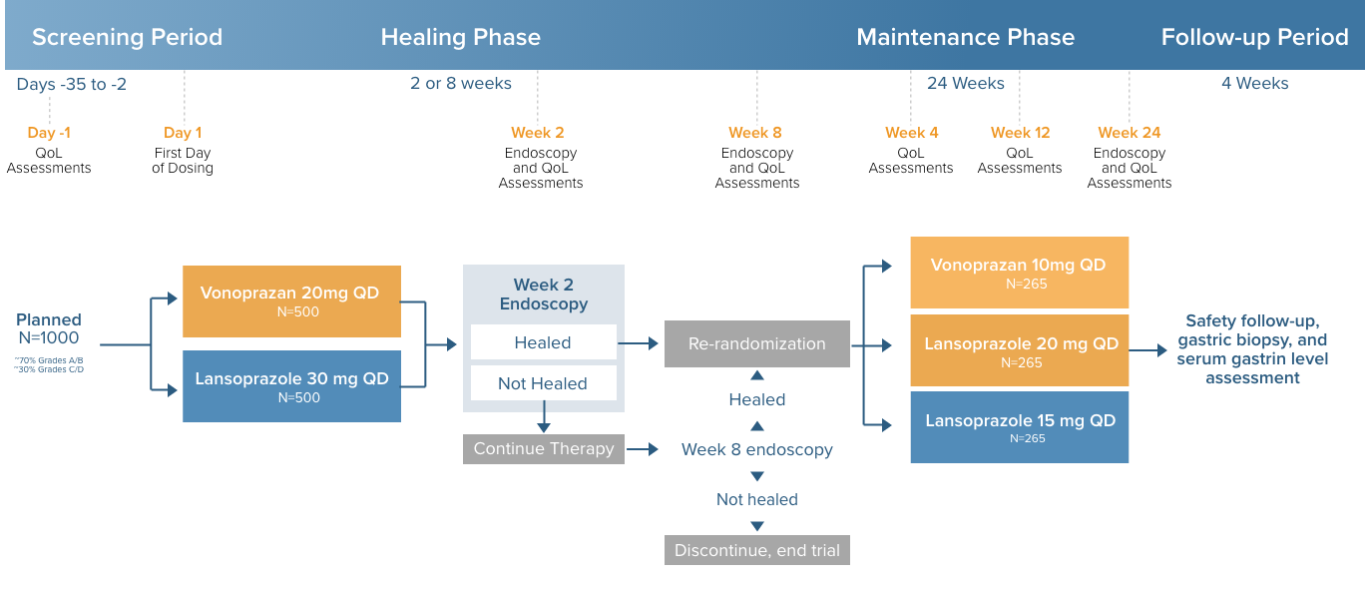

Slide 92
Study design
PHALCON-EE was a trial with two phases. In the first phase, vonoprazan 20 mg was compared to lansoprazole 30 mg in the healing of EE after up to 8 weeks of treatment (Healing Phase).
In the Healing Phase, patients were assessed via endoscopy to determine complete healing following 2 weeks of treatment and, if complete healing was not achieved, a second endoscopy occurred at 8 weeks of treatment.
Patients who achieved complete healing were re-randomized into the second phase of the trial, where vonoprazan 10 mg and 20 mg were compared to lansoprazole 15 mg to assess maintenance of healing via endoscopy following 24 weeks of treatment (Maintenance Phase).
Heartburn symptom relief was assessed via secondary endpoints in both the Healing and Maintenance Phases of the study based on twice daily e-diary data collection.

Slide 93
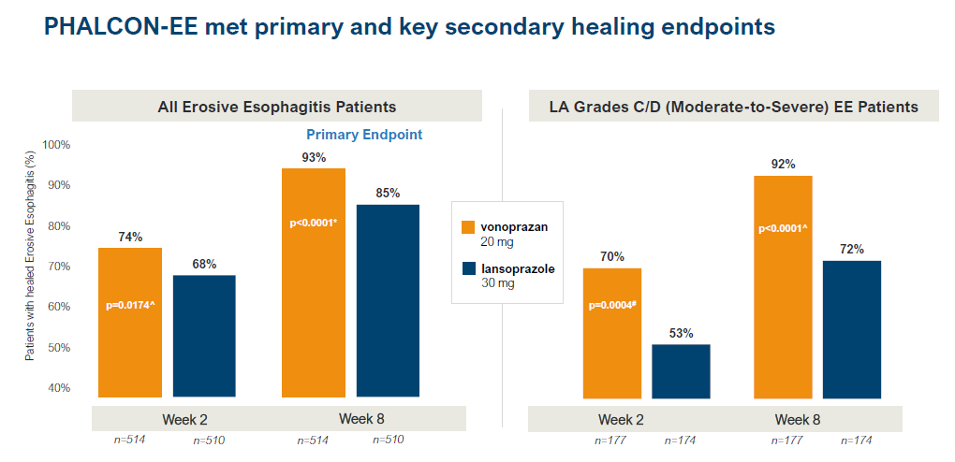

Slide 94
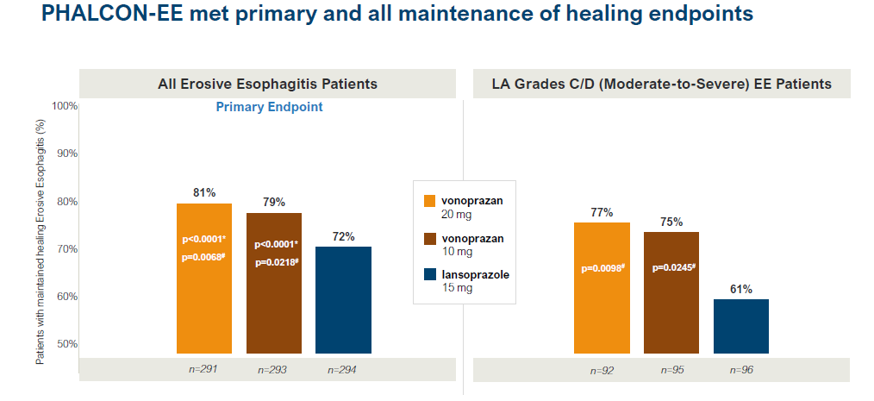

Slide 95
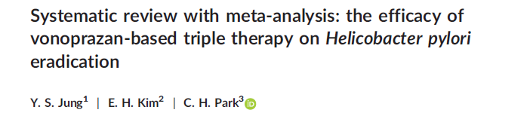
The vonoprazan-based triple therapy showed superior efficacy in terms of H. pylori eradication as compared to the PPI-based triple therapy.
In addition, the vonoprazan-based triple therapy showed comparable tolerability and incidence of adverse events.

Slide 96

Forest plot of the relative efficacy in terms of eradication between the vonoprazan-based and PPI-based triple therapies in the ITT analysis. PPI, proton pump inhibitor; ITT, intention-to-treat; CI, confidence interval

Slide 97

Forest plot of the relative efficacy in terms of eradication between the vonoprazan-based and PPI-based triple therapies among clarithromycin-resistant strains (ITT-analysis). PPI, proton pump inhibitor; ITT, intention-to-treat; CI, confidence interval

Slide 98

We performed a retrospective pharmacovigilance disproportionality analysis using the Japanese Adverse Drug Event Report (JADER) database.
Adverse event reports submitted to the Pharmaceuticals and Medical Devices Agency between 2004 and 2017 were analyzed.

Slide 99
Hepatic and skin disorders were commonly detected in both PPIs and vonoprazan.
There was a significant association of interstitial lung disease with PPIs as a class (ROR: 1.61, 95%CI: 1.47-1.77), but not with vonoprazan.

Slide 100

The safety outcomes for vonoprazan are similar to those for PPIs.

Slide 101

The main pharmacological properties of vonoprazan

Slide 102

The main differences in the mechanisms of action between PPIs and P-CABs

Slide 103
Conclusion
Vonoprazan overcomes many of the weakness of traditional PPI.
Vonoprazan is superior to conventional PPIs for suppressing acid secretion.
Vonoprazan offers the advantage of not being required to be taken before meals.

Slide 104


Slide 105

شكراً لإصغائكم

Slide 106


Slide 107
Current indications and appropriate use of PPI therapy

Slide 108


Slide 109

New drug development for gastric acid inhibition

Slide 110
Pharmacokinetics
P CABs are weak bases, protonated forms of these drugs inhibit H+, K+ ATPase enzyme.
Pka of these drugs varies from 5.6 to 9.3(Vonoprazan).
Binding of P CABs to the proton pump is ionic and its effects are reversible and dose-dependent.
Meals have no effect on rate of absorption, attains C max in 2 h.
T half in plasma is more than 9 h (Vonoprazan).

Slide 111

Vonoprazan

Slide 112


Slide 113

Dual : amoxicillin 500 mg + vonoprazan 20 mg
Triple : amoxicillin 500 mg + vonoprazan 20 mg + clarithromycin 500 mg

