Slide 1
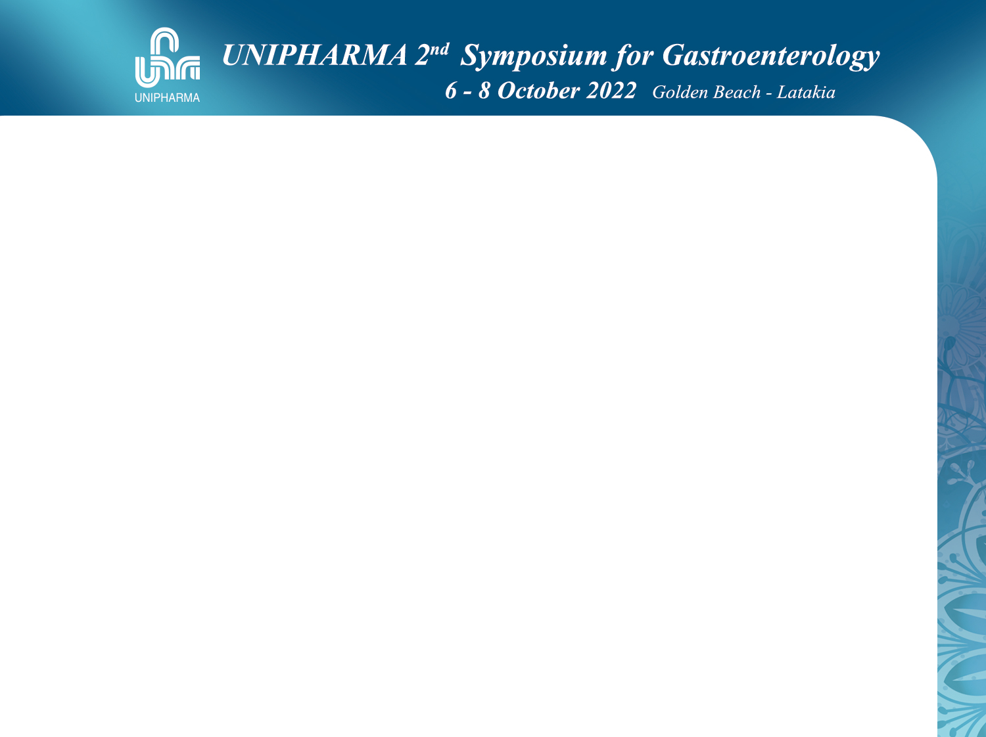

Nazir Ibrahim
MD,MRCP
Associate Professor
Coauthor Cochrane collaboration
Chairman of MAFLD Group (AASLD)
Member of national committee for viral hepatitis

Slide 2
NH3 in Hepatic encephalopathy
2022/10/7
UNIPHARMA Lattakia
Nazir Ibrahim
MRCP (UK

Slide 3
DEFINITION OF HE
is a brain dysfunction caused by liver
insufficiency and/or PSS
manifests as a wide spectrum of neurological or psychiatric abnormalities ranging from
subclinical alterations to coma.
Notes:
This definition, in line with previous versions, is based on the concept that encephalopathies are “diffuse
disturbances of brain function” and that the adjective “hepatic” implies a causal connection to liver insufficiency
and/or perihepatic vascular shunting.

Slide 4
HE
Hepatic
Liver insufficiency
Peri-hepatic vascular shunting

Slide 5
West Haven Criteria (Grade I-IV) +Glasgow scale in IV
SONIC
covert HE (CHE) includes
minimal and Grade I HE
overt HE (OHE)
encompasses Grade II-IV HE.

Slide 6
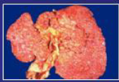

Neuropsychological and/or Neurophysiological tests
COVERT
OVERT
N
HE
minor or No signs/symptoms
SONIC (Spectrum of Neuro-cognitive Impairment in Cirrhosis)

Slide 7
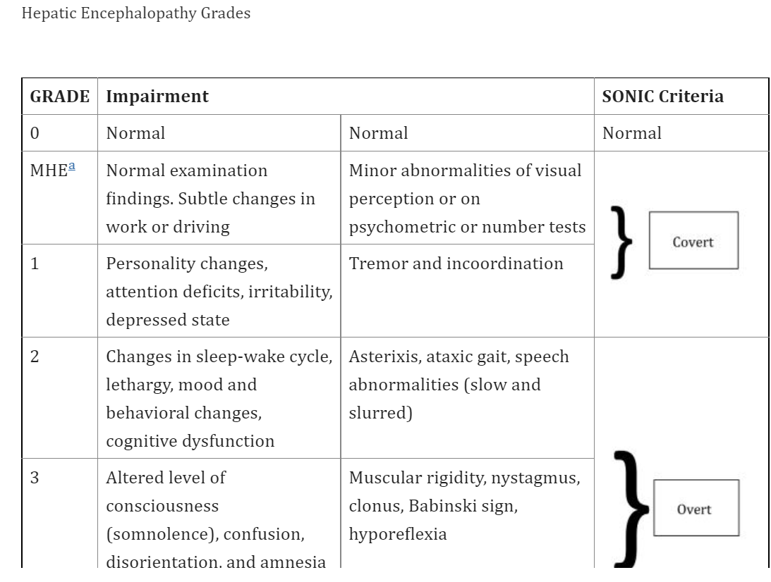
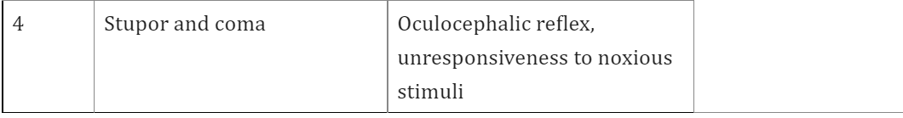
symptoms
Signs
Glasgow scale

Slide 8
Recognised precipitating events are
Constipation
Gastrointestinal bleeding,
Infections
Hyponatremia
Dehydration/Diuretic overdose.

Slide 9
The most critical pathophysiologic mechanism of HE is
cerebral edema
following systemic hyperammonemia.

Slide 10
Astrocytes
The only cells that are responsible for
ammonia detoxification in the brain

Slide 11
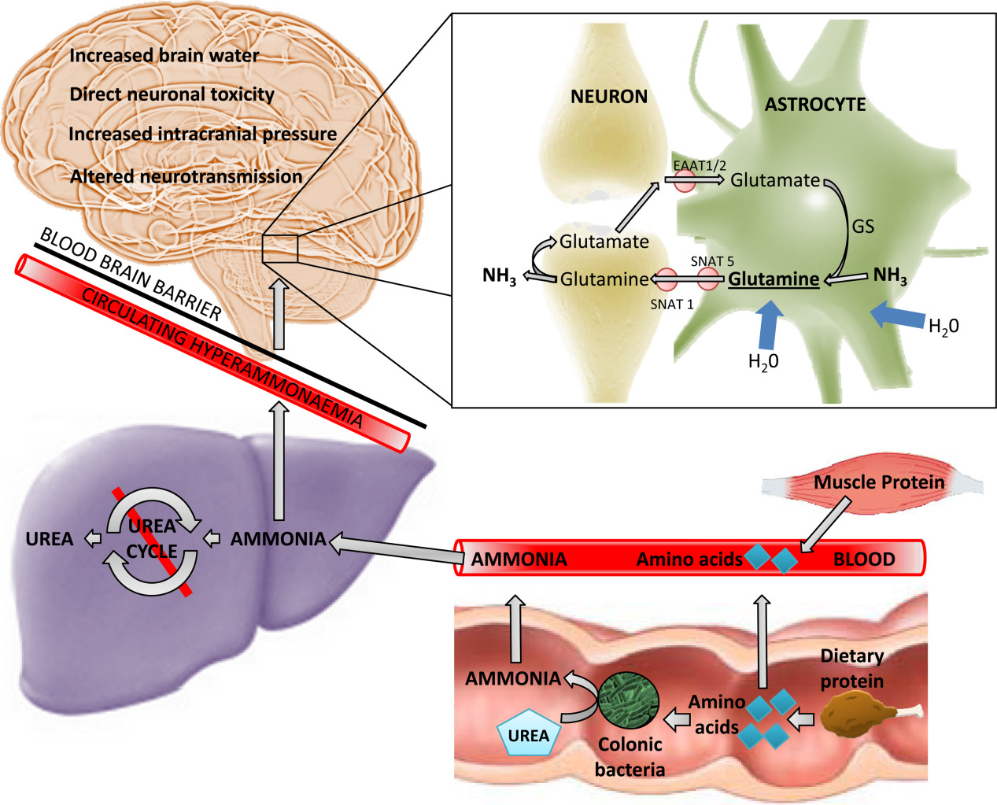
Pathophysiological mechanisms of hepatic encephalopathy
Clinical Liver Disease, Volume: 5, Issue: 3, Pages: 59-63, First published: 21 April 2015, DOI: (10.1002/cld.445)
Notes:
The role of ammonia in the development of hepatic encephalopathy. Decreased hepatic urea‐cycle metabolism in the context of liver cirrhosis and/or portosystemic shunting leads to the accumulation of ammonia (NH3), a product of protein catabolism, in the systemic circulation. Ammonia readily crosses the blood–brain barrier and is metabolized in a cerebral detoxification pathway by GS, with the formation of glutamine occurring exclusively in cerebral astrocytes. Accumulation of glutamine exerts an osmotic effect, with the influx of water leading to astrocytic swelling. Glutamine is shuttled via transporters (SNAT 5/SNAT 1) to presynaptic neurones and converted to GABA or glutamate before release into the inhibitory or excitatory synaptic cleft, respectively, and subsequently scavenged by astrocytic reuptake transporters (EAAT1/2).
IF THIS IMAGE HAS BEEN PROVIDED BY OR IS OWNED BY A THIRD PARTY, AS INDICATED IN THE CAPTION LINE, THEN FURTHER PERMISSION MAY BE NEEDED BEFORE ANY FURTHER USE. PLEASE CONTACT WILEY'S PERMISSIONS DEPARTMENT ON PERMISSIONS@WILEY.COM OR USE THE RIGHTSLINK SERVICE BY CLICKING ON THE 'REQUEST PERMISSIONS' LINK ACCOMPANYING THIS ARTICLE. WILEY OR AUTHOR OWNED IMAGES MAY BE USED FOR NON-COMMERCIAL PURPOSES, SUBJECT TO PROPER CITATION OF THE ARTICLE, AUTHOR, AND PUBLISHER.

Slide 12
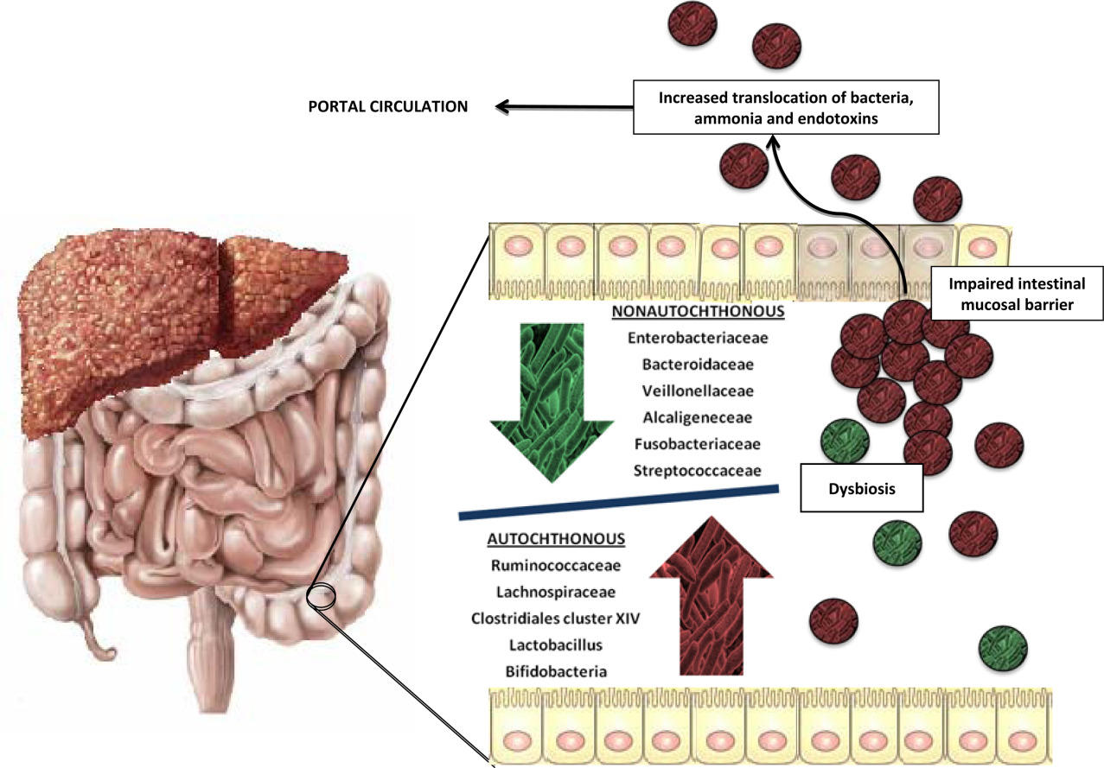
Pathophysiological mechanisms of hepatic encephalopathy
Clinical Liver Disease, Volume: 5, Issue: 3, Pages: 59-63, First published: 21 April 2015, DOI: (10.1002/cld.445)
Notes:
The role of ammonia in the development of hepatic encephalopathy. Decreased hepatic urea‐cycle metabolism in the context of liver cirrhosis and/or portosystemic shunting leads to the accumulation of ammonia (NH3), a product of protein catabolism, in the systemic circulation. Ammonia readily crosses the blood–brain barrier and is metabolized in a cerebral detoxification pathway by GS, with the formation of glutamine occurring exclusively in cerebral astrocytes. Accumulation of glutamine exerts an osmotic effect, with the influx of water leading to astrocytic swelling. Glutamine is shuttled via transporters (SNAT 5/SNAT 1) to presynaptic neurones and converted to GABA or glutamate before release into the inhibitory or excitatory synaptic cleft, respectively, and subsequently scavenged by astrocytic reuptake transporters (EAAT1/2).
IF THIS IMAGE HAS BEEN PROVIDED BY OR IS OWNED BY A THIRD PARTY, AS INDICATED IN THE CAPTION LINE, THEN FURTHER PERMISSION MAY BE NEEDED BEFORE ANY FURTHER USE. PLEASE CONTACT WILEY'S PERMISSIONS DEPARTMENT ON PERMISSIONS@WILEY.COM OR USE THE RIGHTSLINK SERVICE BY CLICKING ON THE 'REQUEST PERMISSIONS' LINK ACCOMPANYING THIS ARTICLE. WILEY OR AUTHOR OWNED IMAGES MAY BE USED FOR NON-COMMERCIAL PURPOSES, SUBJECT TO PROPER CITATION OF THE ARTICLE, AUTHOR, AND PUBLISHER.

Slide 13
Progress in the area has been hindered by the complex pathogenesis that is not yet fully elucidated.
Clinical Liver Disease, Volume: 5, Issue: 3, Pages: 59-63, First published: 21 April 2015, DOI: (10.1002/cld.445)
Notes:
The role of ammonia in the development of hepatic encephalopathy. Decreased hepatic urea‐cycle metabolism in the context of liver cirrhosis and/or portosystemic shunting leads to the accumulation of ammonia (NH3), a product of protein catabolism, in the systemic circulation. Ammonia readily crosses the blood–brain barrier and is metabolized in a cerebral detoxification pathway by GS, with the formation of glutamine occurring exclusively in cerebral astrocytes. Accumulation of glutamine exerts an osmotic effect, with the influx of water leading to astrocytic swelling. Glutamine is shuttled via transporters (SNAT 5/SNAT 1) to presynaptic neurones and converted to GABA or glutamate before release into the inhibitory or excitatory synaptic cleft, respectively, and subsequently scavenged by astrocytic reuptake transporters (EAAT1/2).
IF THIS IMAGE HAS BEEN PROVIDED BY OR IS OWNED BY A THIRD PARTY, AS INDICATED IN THE CAPTION LINE, THEN FURTHER PERMISSION MAY BE NEEDED BEFORE ANY FURTHER USE. PLEASE CONTACT WILEY'S PERMISSIONS DEPARTMENT ON PERMISSIONS@WILEY.COM OR USE THE RIGHTSLINK SERVICE BY CLICKING ON THE 'REQUEST PERMISSIONS' LINK ACCOMPANYING THIS ARTICLE. WILEY OR AUTHOR OWNED IMAGES MAY BE USED FOR NON-COMMERCIAL PURPOSES, SUBJECT TO PROPER CITATION OF THE ARTICLE, AUTHOR, AND PUBLISHER.

Slide 14
HE
No single pathophysiology explains in full its development
Ammonia plays a central role
in the pathophysiology of HE .

Slide 15
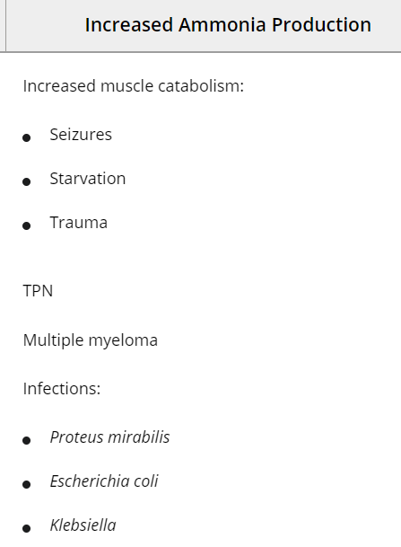
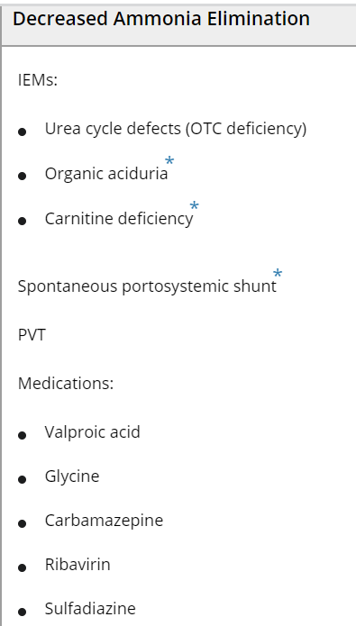
Non hepatic causes

Slide 16
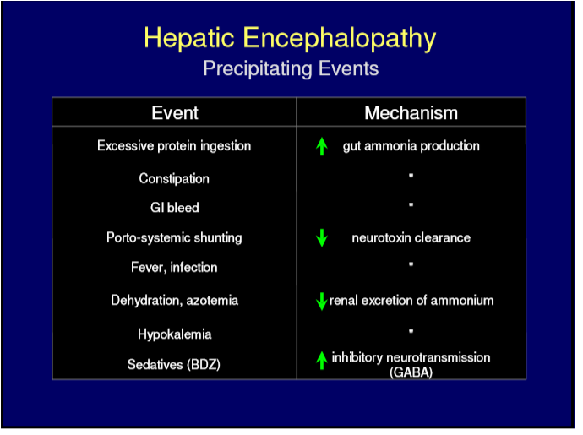

Slide 17
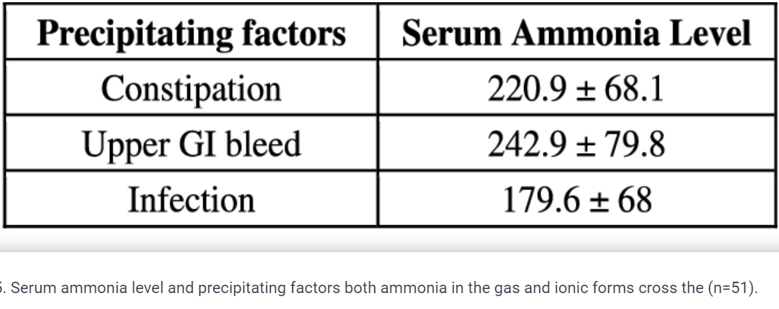

Slide 18
There has been much debate on the use of ammonia measurement in clinical practice.

Slide 19
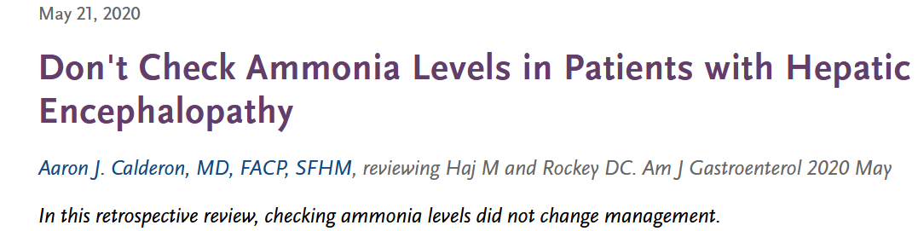

some clinicians routinely order ammonia levels in patients with suspected HE
This study supports that recommendation and suggests that ammonia testing does not change management and should be abandoned altogether.

Slide 20
Diagnosis.
Can patients
without manifest HE
and even
without liver disease
Have hyperammonaemia
YES

Slide 21
Is possible that ammonia may remain elevated after clinical HE resolution.
YES

Slide 22
The role of ammonia measurement in guiding HE treatment ?
has been well studied?
NO Has Not

Slide 23
YES
Is lowering Ammonia inconsistently associated with clinical treatment response?
Is lowering ammonia drug expensive ?
Is it with many side effects ?
Is it not easily available?
Is it effective
NO
YES

Slide 24
Would you use/try
A drug which is
-Safe
-Cheap,
-been Long in use
- effective in lowering Ammonia.
-with good clinical response
in patients with
overt HE & known chronic liver disease
without checking the Ammonia.

Slide 25
Would you use/try
A drug which is
-Safe
-Cheap
-been Long in use
- effective in lowering Ammonia.
-with good clinical response
in patients with
overt HE & known chronic liver disease
without checking the Ammonia.

Slide 26
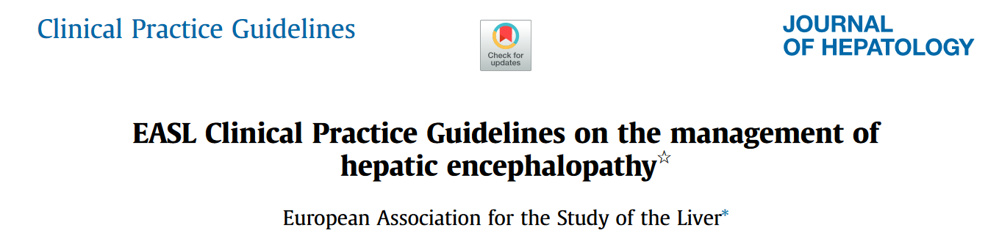
2022

Slide 27
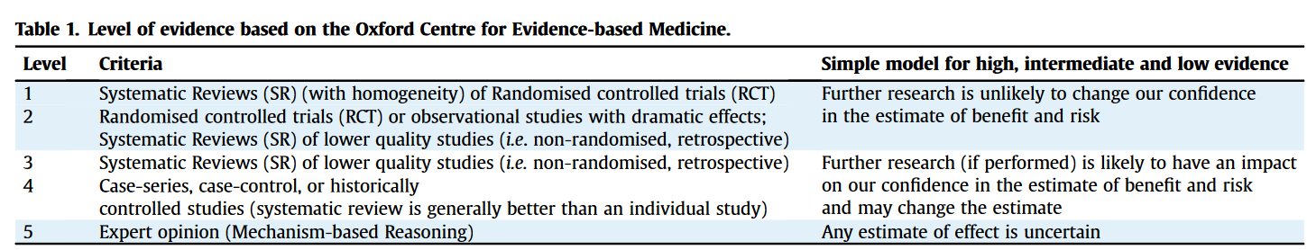

Slide 28
Tailoring HE therapy using
ammonia monitoring
cannot be routinely recommended.
EASL Guidelines 2022

Slide 29
Ammonia level has negative predictive value,
and
normal ammonia in a patient with cirrhosis and delirium should prompt renewed
or
further differential diagnostic work- up for other causes of delirium

Slide 30
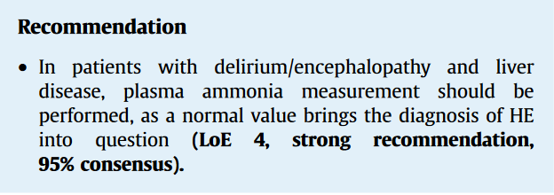
EASL Guidelines 2022

Slide 31
.
High serum ammonia levels alone
add No value to patients with chronic liver disease who experience HE.
Diagnostic
staging
Prognostic

Slide 32
A post hoc analysis
patients with cirrhosis and 2 episodes of overt HE
showed
The level of ammonia after recovery was predictive
of the onset of new episodes of HE
even with mild hyperammonaemia
Notes:
Post hoc in Latin means 'after this'. Simply put, a post-hoc analysis refers to a statistical analysis specified after a study has been concluded and the data collected. A post-hoc test is done to identify exactly which groups differ from each other. Therefore, such tests are also called multiple comparison tests

Slide 33
Recommendations
Lactulose is recommended as secondary prophylaxis
following a first episode of overt HE, and should be titrated to obtain 2-3 bowel movements per day
(LoE 1,strong recommendation, 96% consensus).
Rifaximin as an adjunct to lactulose is recommended as secondary prophylaxis following >−1 additional episodes of overt HE within 6 months of the first one (LoE 2, strong recommendation, 92% consensus)

Slide 34
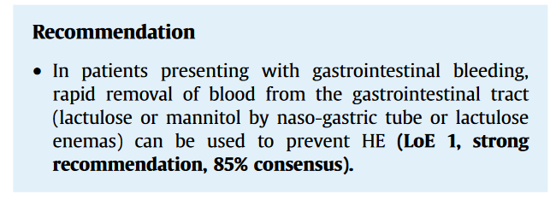
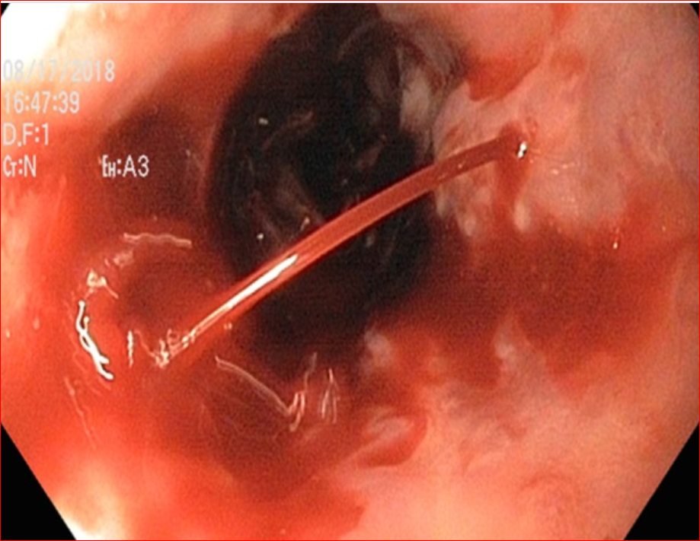

Slide 35
Conclusions 1
In overt HE with clear cut CLD not sure need to check
You could do it at firest as normal level raise question of HE diagnosis
And start therapy without the need to wait level
When start treatment with good response no need
Do not titer the dose of Lactulose according to ammonia level ,be guided by clinical response

Slide 36
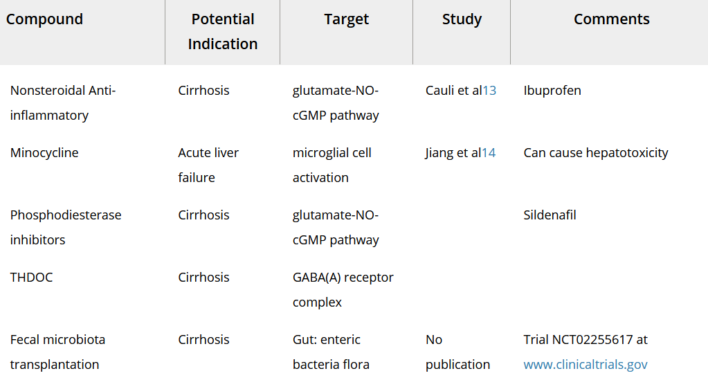

Slide 37
