Slide 1
Anal fissure
Bisher Daaboul MD.

Slide 2
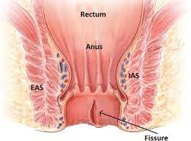
Definition:
A tear in the lining of the anal canal.
Primary or secondary.
Reduced blood flow.
Acute or chronic (> 8 weeks).
Anal pain and bleeding.

Slide 3
Location:
Choose the correct answer:
More common in the anterior midline.
Could be anywhere of the anal canal.
The vast majority are in the posterior midline.
The kissing fissures are present in 25% of cases.
Lateral fissures are more common with severe constipation.

Slide 4
Location:
More common in the anterior midline.
Could be anywhere of the anal canal.
The vast majority are in the posterior midline.
The kissing fissures are present in 25% of cases.
Lateral fissures are more common with severe constipation.

Slide 5
Diagnosis:
Choose the correct answer:
Anoscopy in mandatory to make the diagnosis.
Both fissures and hemorrhois induce severe pain.
Bleeing is present in almost all cases.
Anal spasm is one of the main specific symptoms.

Slide 6
Diagnosis:
Anoscopy in mandatory to make the diagnosis.
Both fissures and hemorrhois induce severe pain.
Bleeing is present in almost all cases.
Anal spasm is one of the main specific symptoms.

Slide 7
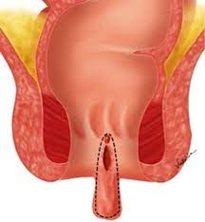
Diagnosis:
Classical symptoms, pain induced by defecation and reproduced by digital exam.
Rectal bleeding.
Anoscopy, sigmoidoscopy, colonoscopy.
Chronic fissures are associated with skin tags due to chronic inflammation and fibrosis.

Slide 8

Treatment:
High fiber diet.
Sitz bath.
Topical analgesics.
Laxatives.
Topical vasodilators.

Slide 9
Treatment:
Choose the correct answer:
Topical steroids helps in healing anal fissures.
Flavoids compounds was found to be effective in clinical trials.
Topical Nitroglycerin helps but can induce headache.
Topical nifedipine should not be mixed with lidocaine.

Slide 10
Treatment:
Topical steroids helps in healing anal fissures.
Flavoids compounds was found to be effective in clinical trials.
Topical Nitroglycerin helps but can induce headache.
Topical nifedipine should not be mixed with lidocaine.

Slide 11
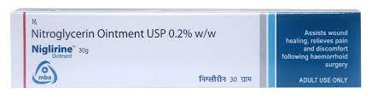
Topical ntg:
NTG increases blood flow and reduces pressure in the internal anal sphincter.
0.2-0.4% for 8 weeks.
A meta-analysis found it to be superior to placebo (49 vs 36%).
50% recurrence rate.
Headache in 15 minutes after application. It decreases within 2 weeks.

Slide 12
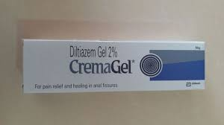
Topical nifedipine:
0.2-0.3%
It reduces the sphincter pressure.
More effective than NTG (89 vs 58%) and fewer side effects (5 vs 40%).
The recurrence rate is 40%.

Slide 13
Follow up:
If not healed within 2 months crohn’s should be ruled out.
If it was ruled out then botox or surgery should be considered.

Slide 14
Botulinum toxin injection:
10-100 IU can be injected.
27 gauge needle.
70% success rate.
Can be repeated within 2 months.
Temporary incontinence can occur in 7% of cases.

Slide 15
Lateral internal sphincterotomy:
Choose the correct answer:
Can be performed in the office with local anesthesia.
Same recurrence rate (local vs general anesthesia).
A midline posterior sphincterotomy is as effective as the lateral one.
The risk of incontinence is very low (<10 %).

Slide 16
Lateral internal sphincterotomy:
Can be performed in the office with local anesthesia.
Same recurrence rate (local vs general anesthesia).
A midline posterior sphincterotomy is as effective as the lateral one.
The risk of incontinence is very low (<10 %).

Slide 17
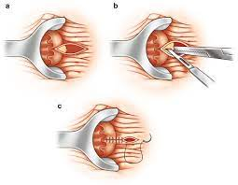
Surgery:
Avoid women with multiple vaginal deliveries, and older patients.
A lateral internal sphincterotomy provides symptomatic relief in 95% of patients within 3 weeks.
The Lord’s (4 finger dilation) is associated with a high incidence of sphincter tear and incontinence and has been abandoned.

Slide 18
Follow up:
Risk of incontinence was reported to be 14% in a meta-analysis of 4512 patients.
9% flatus incontinence, 6% seepage, 1% accidental defecation.
Other reports 30-45% rate of immediate minor incontinence, and in 6-30% this may last.
50% of women who had multiple vaginal deliveries.

Slide 19
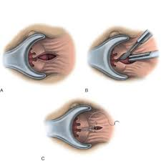
Fissurectomy:
Excision of the anal fissure.
Low risk of recurrence (11%) and incontinence.
Could be used in conjunction with botox injection with a healing rate of 70-80%, incontinence rate of 3-7%, and recurrence rate of 0-17%

Slide 20
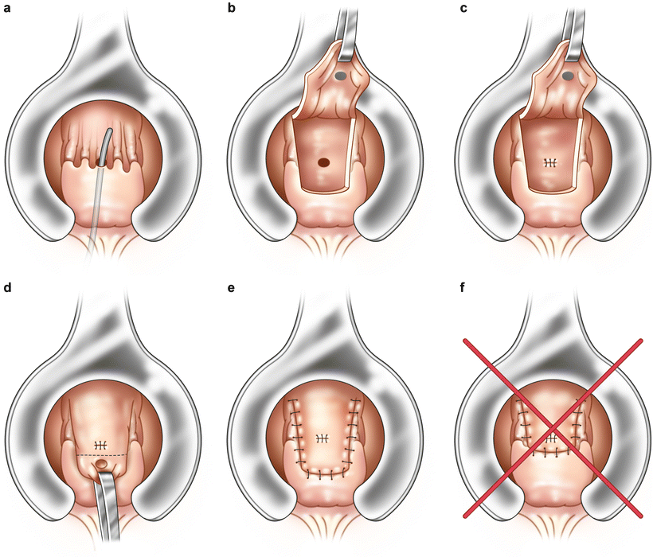
Anal advancement flap:
Dose not divide the sphincter.
Not associated with any increased risk of fecal incontinence.
Suitable for women and elderly patients.
Helps especially patients with no hypertenocity.

Slide 21
Refractory cases:
High fiber and ample fluid intake.
Rule out secondary fissures.
Repeat sphincterotomy on the contralateral side, with fissurectomy.

