Slide 1
ملاحظات حول تدبير القرحة النازفة
بشر موفق دعبول

Slide 2
Introduction
Most cases stop spontaneously.
Despite advances in endoscopic and pharmacological therapy, the mortality rate did not improve.
High risk stigmata: active bleeding, visible vessel, adherent clot.
Low risk stigmata: flat pigmented spot, clean base ulcer.

Slide 3
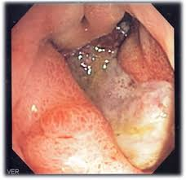
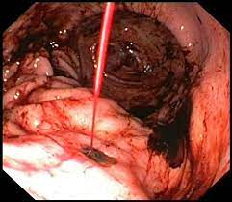

Slide 4
Question 1
A 74 YOM who presented with 3 hrs history of hematemesis. He feels dizzy, looks pale, is known to have CAD, and is on ASA for 10 years. BP is 10/6, hgb is 10, you are called by the ER physician asking for an urgent consult and informing you that the patient and the family are very anxious.
how soon are you supposed to scope this pt?
As soon as possible.
Within 4 hrs.
In 12-24 hrs.
Not before he is completely stable.

Slide 5
Question 2
Which one of the following statements is wrong regarding the initial approach to the bleeding ulcer:
Patient can be managed on an outpatient bases if stable and have a pigmented spot.
Blood transfusion should be initiated if hgb < 7.
One large bore IV line should be enough.
Older age, anticoagulation treatment, and CAD are considered high risk comorbidities.

Slide 6
Question 3
Which one of the following statements is true regarding pharmacologic therapy:
The IV PPI can be started before endoscopy.
The IV PPI can be started after endoscopy.
The IV PPI can be given in high bolus (80 mg) the 8 mg per hour.
The IV PPI can be given twice daily.
All of the above are correct.

Slide 7
Oral therapy
High risk ulcers should be treated with twice daily oral PPI after the first 72 hrs of IV PPI, and for 2 weeks and then once daily.
Low risk ulcers can be treated with once daily oral PPI upon endoscopy.
H. pylori should be eliminated.

Slide 8
Question 4
Which of the following statements is false in regards to the treatment of bleeding ulcer with somatostatin and octeriotide:
They can inhibit gastric acid secretion.
They have gastric cytoprotective effects.
They are more effective than PPI and endoscopic therapy.
Their role is limited to settings were endoscopy is not available or contraindicated.
The octeriotide dose is 50 mcg bolus followed by an infusion of 25 mcg/hr.

Slide 9
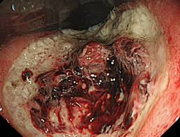
Managing adherent clot
The safest approach is to try to remove the clot gently with suction and gentle irrigation, and apply thermal therapy afterwards.
Using the cold snare to remove the clot is recommended if:
The ulcer site is easily reached.
Thermal therapy is available.
Enough experience is available.
Surgical / interventional radiology support are available.
Results of meta-analysis are not consistant.

Slide 10
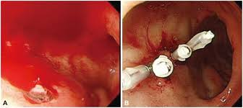
Question 5
Which one of the following statements is true in regards to the endoscopic therapy:
Injection therapy is enough in most cases.
Clips are more effective than thermal therapy.
Standard approach include thermal coagulation or clips and can be combined with injection therapy.
Endoscopic therapy should be used in all types of bleeding ulcers.

Slide 11
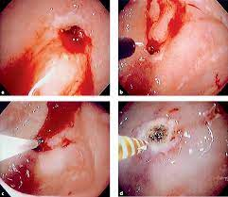
Question 6
Which one of the following statements is false in regards to injection therapy:
Easy to be administered.
Can produce a cleaner field.
Higher dilution (1/100,000) is recommended in the GEJ or in cardiac patients.
Ethanolamine is also recommended.
Absolute ethanol can also be used.

Slide 12
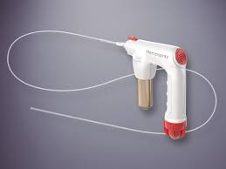
Alternative approaches
Fibrin sealant needs to be repeated daily until the visible vessel disappear.
Hemostatic sprays: a nanopowder or starched-derived that promotes hemostasis.
Easy to apply, and is recommended as a temporizing measure to stop bleeding when conventional modalities fail or are not available. It can be used in GI malignancies.

Slide 13
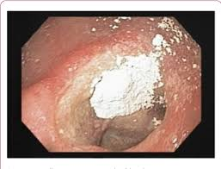
It needs less experience, but should be followed by additional endoscopic treatment since the rebleeding rate may reach up to 10-50%, while the initial success rate is 75-100%.

Slide 14
Second look endoscopy
The recommendations are against the second look unless:
Visualization was limited.
The endoscopic therapy was suboptimal.
If there is an active recurrent bleeding.

Slide 15
The criteria defining recurrent bleed
Hematemesis > 6 hrs after endoscopy.
Melena or hematochezia after stool color normalization.
Tachycardia > 110, or hypotension < 9 after stability.
Hemoglobin drop > 2g after 2 stable readings.
Persistent tachycardia or hypotension > 8 hrs after index endoscopy with persistent melena or hematochezia.
Persistent drop of hgb > 3 g in 24 hrs with melena or hematochezia.

Slide 16
Endoscopy for recurrent bleeding
It works in up to 75% of cases. The rest will need surgery.
Same endoscopic therapy can be used or different one.
Over-the-scope clip (OTSC) is a promising therapeutic option.
Emergency surgery is associated with high mortality rate ( up to 36%).
Interventional angiography success rate is 50-98% but with less complications.

Slide 17
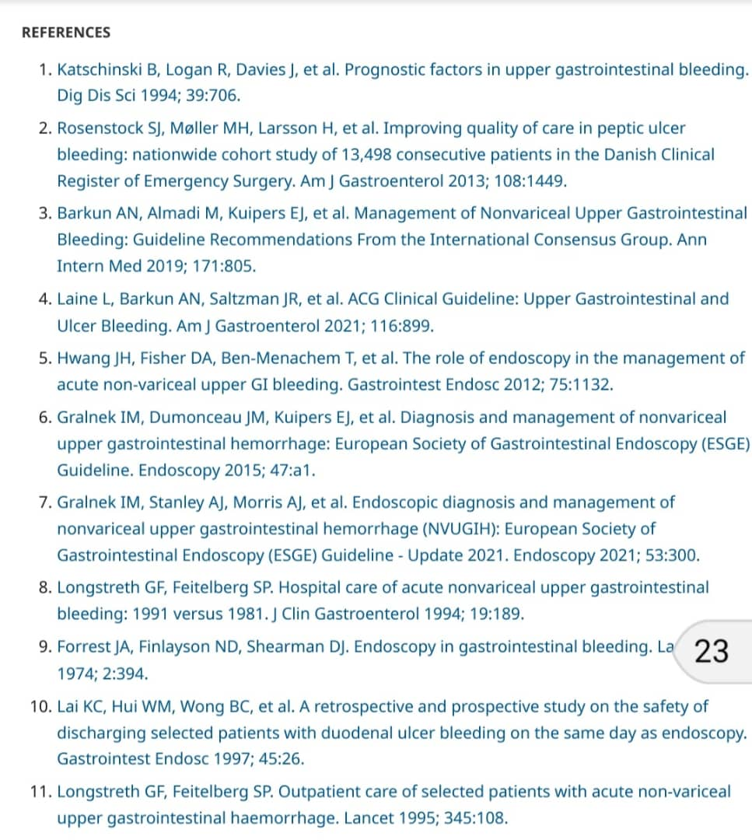

Slide 18
